Slide 1
Microbial Growth

Slide 2
Microbial Growth - refers to the number of cells, not the size of the cells
Requirements for Growth
Physical
Chemical

Slide 3
Physical Requirements
Temperature
psychrophiles (cold loving microbes )
range 0 C - 20 C
mesophiles (moderate temp. loving microbes)
range 20 C - 40 C
thermophiles (heat loving microbes)
range 40 C - 100 C

Slide 4
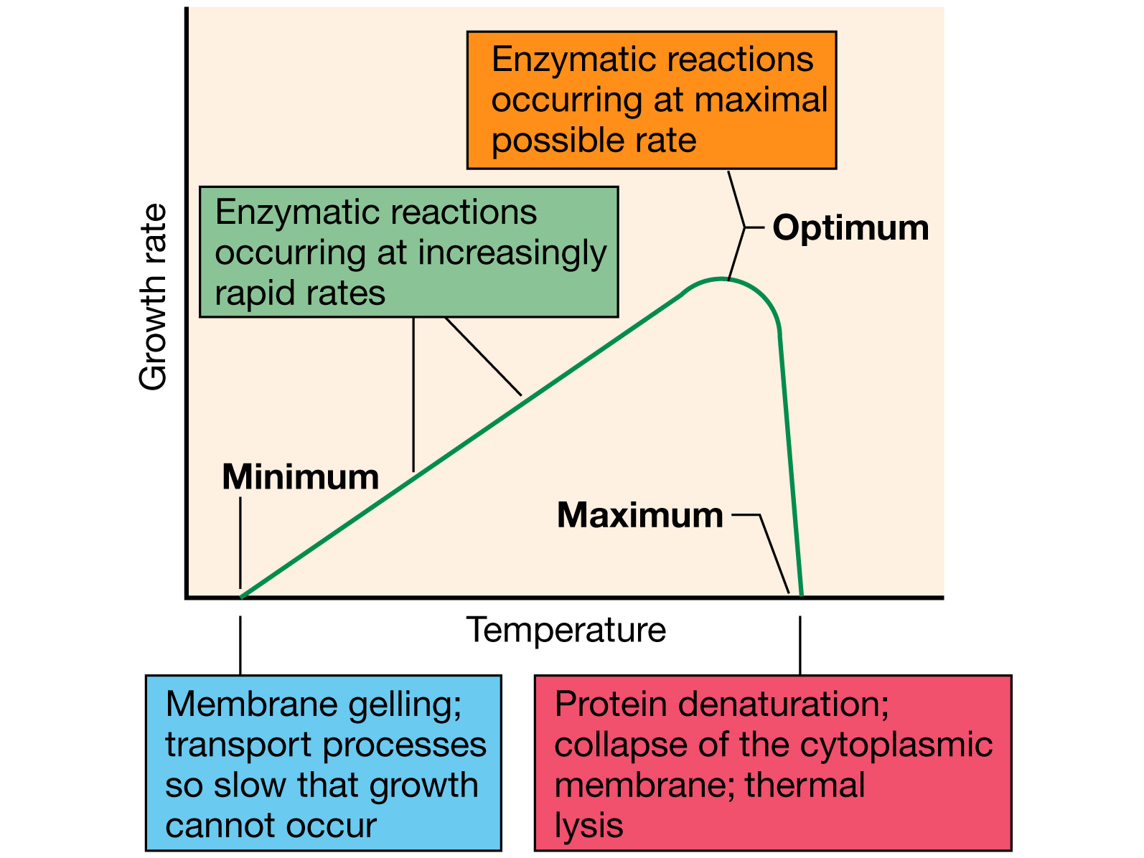
Effect of temperature
Notes:
Figure: 06-16
Caption:
Effect of temperature on growth rate and the molecular consequences for the cell. The three cardinal temperatures vary by organism.

Slide 5
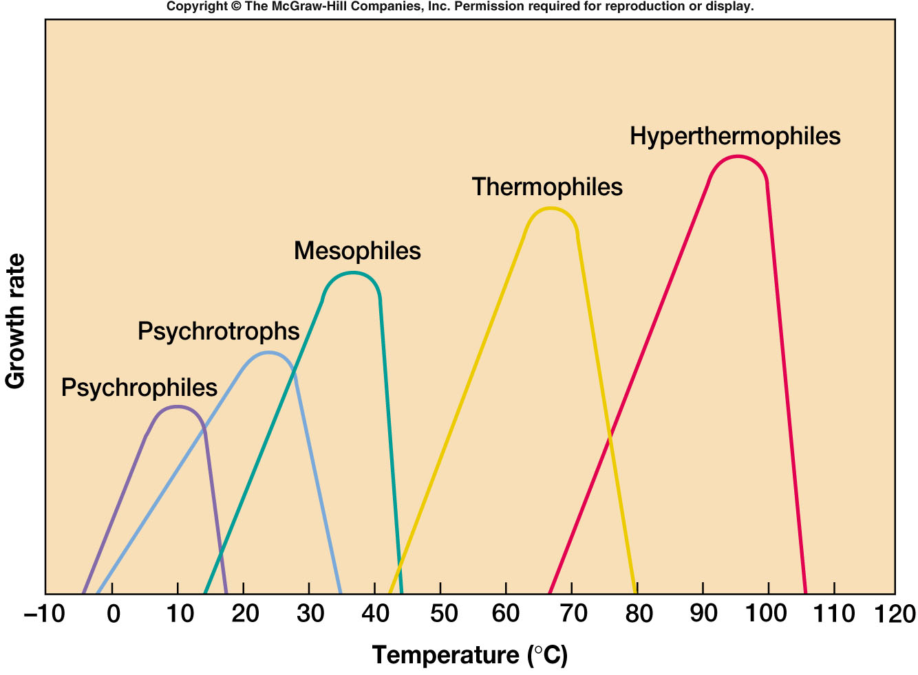

Slide 6
Depending on temperature preferences microorgnisms are grouped into
Psychrophiles: Cold loving. Growth range 0-20ºC with optimum at 10-15ºC.
Mesophiles: Medium temperature loving. Range 20 to 40ºC with optimum at 37ºC.
Thermophiles: High temperature loving. Range 45-70ºC with optimum at 60ºC.
Extreme thermophiles: Growth range 80-120ºC.

Slide 7
How thermophilic are thermophiles?
Growth at high temperature – what is high?
Archaea grow to 121ºC (opt about 113ºC )
Many genera and species grow at or above 100ºC
Bacteria grow to 95ºC (opt about 92ºC )
Few species grow above 85ºC
Cyanobacteria grow to 68ºC
Fungi grow to 60-65ºC
Eucaryotic algae grow to 60ºC
Protozoa grow to 50ºC

Slide 8
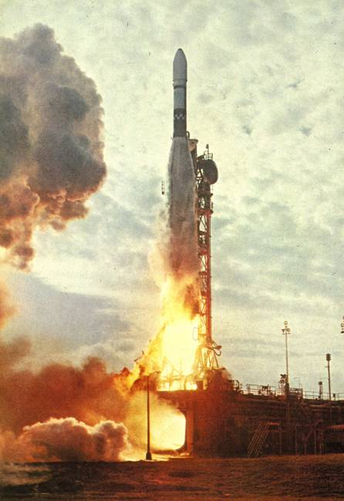
Why study thermophiles
When return flights to the moon were feasible there was concern about the possibility of different life forms existing there and possibly colonising earth. NASA needed to know what extreme conditions bacteria could survive and grow under.
1967 Tom Brock isolated Thermus aquaticus from Yellowstone National Park, USA

Slide 9
MOISTURE CONTENT
Availability of water (a_{w} - known as water activity) is a critical factor that affects the growth of all cells.
The water activity of pure water is 1
Microorganisms live over a range of a_{w} from 1 to 0.7.
Water activities of agricultural soils range between 0.9 to 1.

Slide 10
Microorganisms live in dry and arid environments are known as xerophiles.
A_{w} of blood is 0.99, sea water = 0.98, maple syrup = 0.90, great salt lake = 0.75.

Slide 11
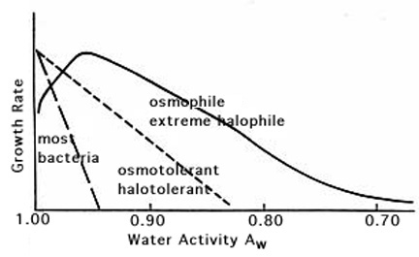
Limiting a_{w} for growth of certain procaryotes.

Slide 12
Chemical Requirements
Macro & Micro Elements
C HOPKINS CaFe Mg NaCl

Slide 13
Chemical: pH
Most bacteria grow between pH 6.5 - pH 7.5
Very few can grow at below pH 4.0
many foods, such as sauerkraut, pickles, and cheeses are preserved from spoilage by acids produced during fermentation

Slide 14
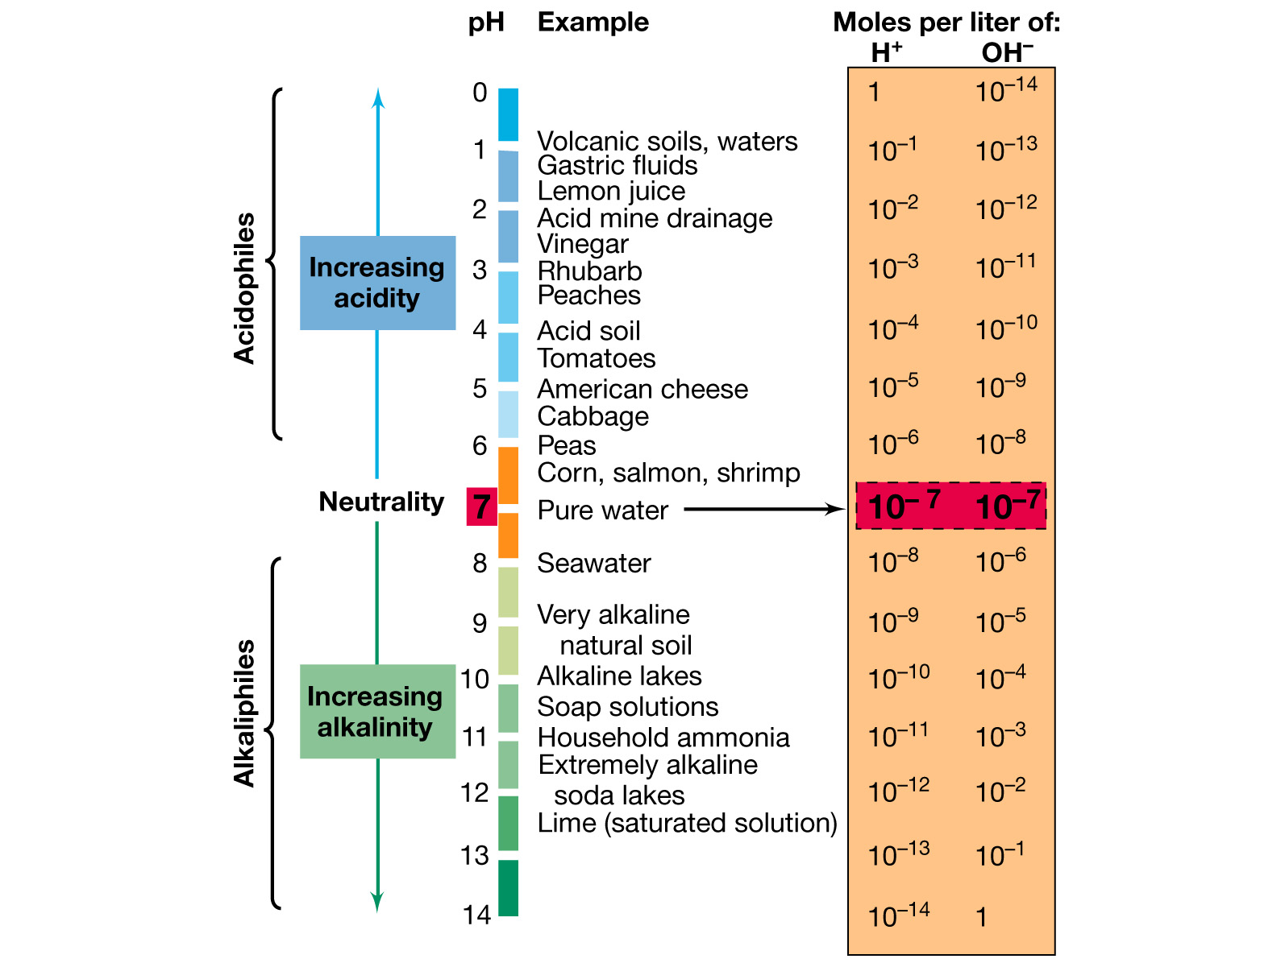
Bacterial growth at various pH
Notes:
Figure: 06-22
Caption:
The pH scale. Note that although some microorganisms can live at very low or very high pH, the cell’s internal pH remains near neutrality.
Most bacteria prefer pH near neutrality. Some require extreme pH however. Most natural habitats have pH of 5-9.
Microorganisms which grow at an optimum pH well below neutrality (7.0) are called acidophiles. Those which grow best at neutral pH are called neutrophiles and those that grow best under alkaline conditions are called alkaliphiles. Obligate acidophiles, such as some Thiobacillus species, actually require a low pH for growth since their membranes dissolve and the cells lyse at neutrality. Several genera of Archaea, including Sulfolobus and Thermoplasma, are obligate acidophiles. Among eukaryotes, many fungi are acidophiles, but the champion of growth at low pH is the eukaryotic alga Cyanidium which can grow at a pH of 0.
In the construction and use of culture media, one must always consider the optimum pH for growth of a desired organism and incorporate buffers in order to maintain the pH of the medium in the changing milieu of bacterial waste products that accumulate during growth. Many pathogenic bacteria exhibit a relatively narrow range of pH over which they will grow. Most diagnostic media for the growth and identification of human pathogens have a pH near 7.

Slide 15
Acidophiles - Optimum pH well below neutrality (7.0). E.g. Thiobaillus, Sulpholobus, Thermoplasma (obligate acidophiles). Cyanidium can grow at pH 0.
Neutrophiles - Grow best at neutral pH. Common genera such as Bacillus, Pseudomonas etc.
Alkaliphiles - Grow best under alkaline conditions.

Slide 16
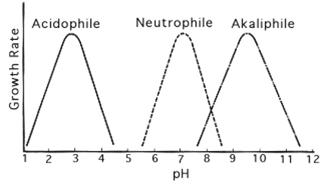
Growth rate versus pH for three environmental classes of procaryotes.

Slide 17
Acidophiles
Archaea hold “world record”
Picrophilus grows at pH -0.6 (and 60C)
Sulfolobus grows at pH 1.0 (and up to 80C)
Bacteria
Thiobacillus grows at pH 1-3
Practically all extreme acidophiles are involved in sulfur or sulfide oxidation. They are therefore autotrophs (and aerobic) and produce sulfate (in the form of sulfuric acid) as an end product of metabolism. They are therefore resistant to low pH only due to the sulfate ion and they will not grow at low pH induced with any other acid.

Slide 18
Alkaliphiles
Obviously grow at high pH – how high?
No natural environments above pH 13 so this represents the upper limit.

Slide 19
Osmotic Pressure
Microbes obtain almost all their nutrients in solution from surrounding water
Tonicity
isotonic
hypertonic
hypotonic

Slide 20
Oxygen
Bacteria can be classified base on their oxygen requirements

Slide 21

1. Obligate Aerobes

Slide 22

2. Obligate Anaerobes

Slide 23

3. Facultative Aerobes
Facultative Anaerobes

Slide 24

4. Microaerophilic

Slide 25
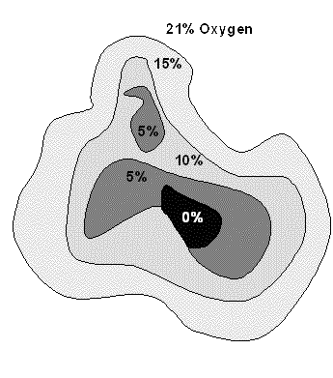
Hypothetical cross-section of a soil particle showing different regions of oxygen availability. In the centre of the particle, oxygen is not available, thus only anaerobic and facultative anaerobic microorganisms would be capable of growth.

Slide 26
Oxygen and growth
Environment
Group
Aerobic
Anaerobic
O₂ Effect
Obligate Aerobe
Growth
No growth
Required (utilized for aerobic respiration)
Microaerophile
Growth if level not too high
No growth
Required but at levels below 0.2 atm
Obligate Anaerobe
No growth
Growth
Toxic
Facultative (An)aerobe
Growth
Growth
Not required for growth but utilized when available
Aerotolerant Anaerobe
Growth
Growth
Not required and not utilized

Slide 27
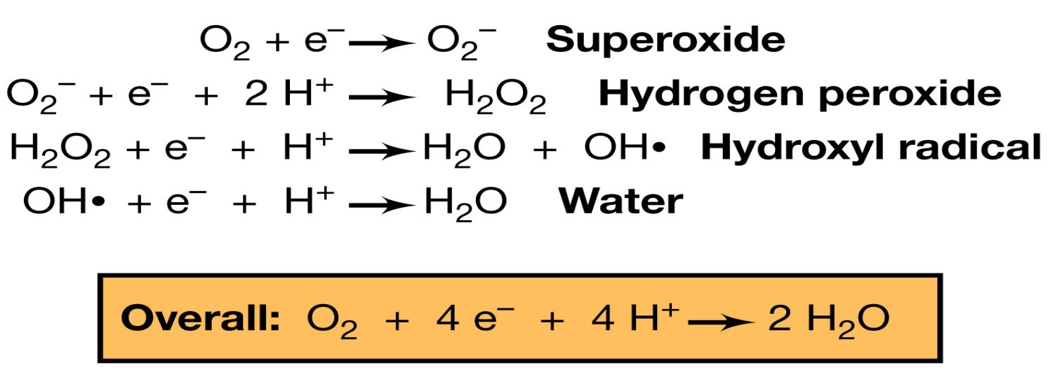
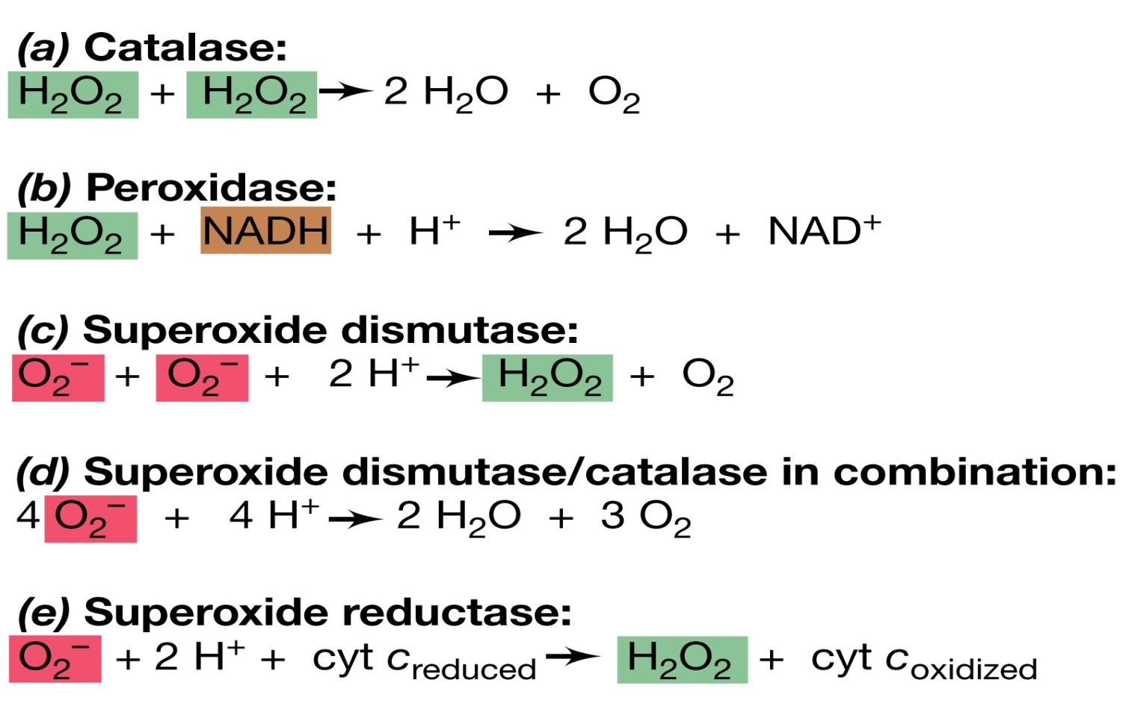
Oxygenation and enzymic capacity
Notes:
Figure: 06-27
Caption:
Four-electron reduction of O₂ to water by stepwise addition of electrons. All the intermediates formed are reactive and toxic to cells except for water, of course.
Figure: 06-28a-e
Caption:
Enzymes that destroy toxic oxygen species. (a) Catalases and (b) peroxidases are porphyrin-containing proteins, although some flavoproteins may consume toxic oxygen species as well. (c) Superoxide dismutases are metal-containing proteins, the metals being copper and zinc, manganese, or iron. (d) Combined reaction of superoxide dismutase and catalase. (e) Superoxide reductase catalyzes the one electron reduction of O₂⁻ to H₂O₂ using reduced cytochrome c as the electron donor.

Slide 28
Oxygen is lethal to some organisms
All organisms produce superoxide ( O₂-)
Superoxide is toxic to cells (steals electrons)
Superoxide must be neutralized

Slide 29
Superoxide dismutase
O₂- + O₂- + 2 H⁺ -------> H₂O₂ + O₂
Hydrogen peroxide is also toxic to cells and it must be neutralized

Slide 30
Catalase
2 H₂O₂ --------> 2 H₂O + O₂
Obligate Anaerobes lack:
Superoxide dismutase ( SOD )
Catalase

Slide 31
Special Culture Techniques
1. Anaerobic Bacteria
a. Reducing Media
b. Anaerobic Container
c. Agar Stab

Slide 32
Special Culture Techniques
2. Microaerophilic Bacteria
grow best under reduced O₂ levels and increased CO₂ levels
Normal Atmosphere 21 % O₂
.3 to .03 % CO₂

Slide 33
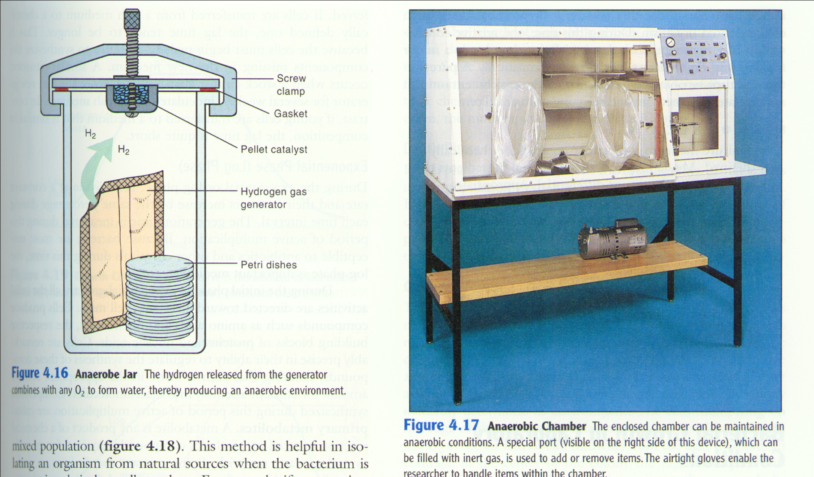
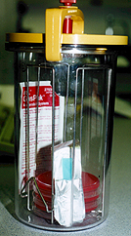
Anaerobic growth chambers
Notes:
To adjust atmospheric conditions for
Capnophiles
Microaerophiles
Anaerobic bacteria
Anaerobic jar principle: H₂ gas (in presence of palladium catalyst) reacts with free O₂ in the air to form water.
Candle jar principle: The flame will use up a certain percentage of the O₂ and elevate the CO₂ before extinguishing.

Slide 34
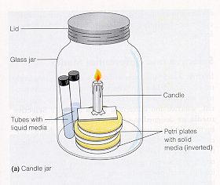
Microaerophilic Bacteria
A. Candle Jar
16 % O₂
4 % CO₂

Slide 35
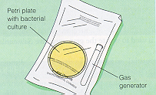
Microaerophilic Bacteria
B. CO₂ Generating Packet

Slide 36
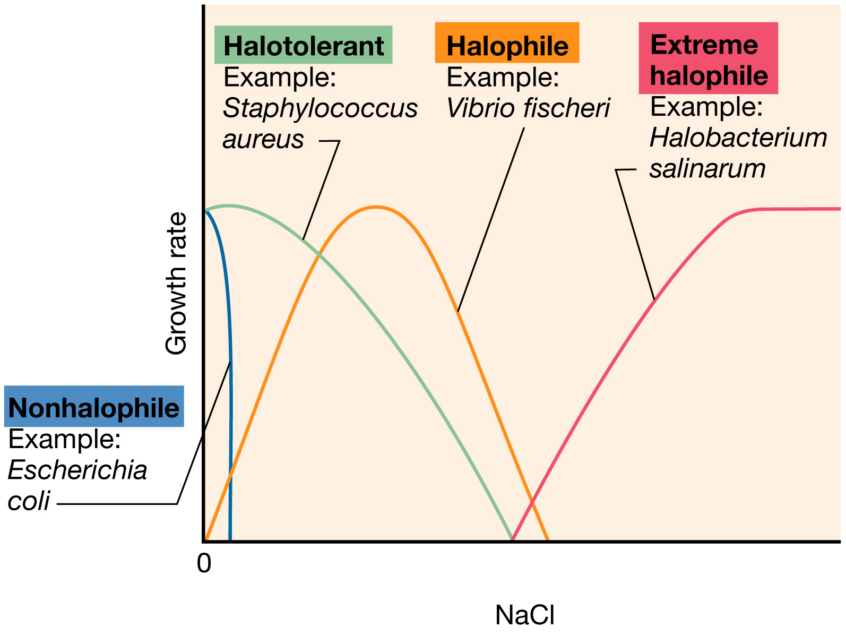
Effect of salt on growth
Notes:
Figure: 06-23
Caption:
Effect of sodium ion concentration on growth of microorganisms of different salt tolerances or requirements. The optimum NaCl concentration for marine microorganisms such as V. fischeri is about 3%; for extreme halophiles, it is between 15 and 30%, depending on the organism.
The only common solute in nature that occurs over a wide concentration range is salt [NaCl], and some microorganisms are named based on their growth response to salt. Microorganisms that require some NaCl for growth are halophiles. Mild halophiles require 1-6% salt, moderate halophiles require 6-15% salt; extreme halophiles that require 15-30% NaCl for growth are found among the archaea. Bacteria that are able to grow at moderate salt concentrations, even though they grow best in the absence of NaCl, are called halotolerant. Although halophiles are "osmophiles" (and halotolerant organisms are "osmotolerant") the term osmophiles is usually reserved for organisms that are able to live in environments high in sugar. Organisms which live in dry environments (made dry by lack of water) are called xerophiles.

Slide 37
Selective Media
Inhibits the growth of some bacteria while selecting for the growth of others
Example:
Brilliant Green Agar
dyes inhibit the growth of Gram (+) bacteria
selects for Gram (-) bacteria
Most G.I. Tract infections are caused by Gram (-) bacteria

Slide 38
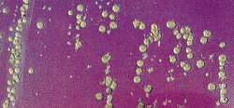
Selective Media
EMB (Eosin Methylene Blue)
dyes inhibit Gram (+) bacteria
selects for Gram (-) bacteria
G.I. Tract infections caused by Gram (-) bacteria

Slide 39
Differential Media
Differentiates between different organisms growing on the same plate
Example:
Blood Agar Plates (TSA with 5% sheep blood)
used to differentiate different types of Streptococci

Slide 40
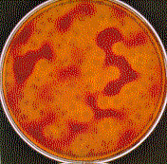
Alpha Hemolytic Streptococci
Incomplete lysis of RBC’s

Slide 41
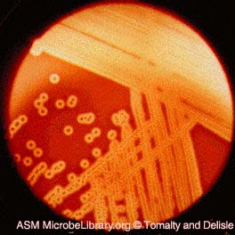
Beta Hemolytic Streptococci
Complete lysis of RBC’s

Slide 42
Gamma Hemolytic Streptococci
No lysis of RBC’s

Slide 43
Selective and Differential Media
Mannitol Salt Agar
used to identify Staphylococcus aureus
Mannitol Salt Agar
High salt conc. (7.5%) inhibits most bacteria
sugar Mannitol
pH Indicator (Turns Yellow when acid)

Slide 44
Selective and Differential Media
MacConkey’s Agar
used to identify Salmonella
MacConkey’s Agar
Bile salts and crystal violet (inhibits Gram (+) bacteria)
lactose
pH Indicator
Many Gram (-) enteric non-pathogenic bacteria can ferment lactose, Salmonella can not

Slide 45
Bacterial Growth - increase in the number of cells
Binary Fission
Generation Time (Doubling Time)
time required for a cell to divide
most about 1 Hr. To 3 Hrs.
E. coli - 20 minutes
Mycobacterium tuberculosis - 24 Hrs.

Slide 46
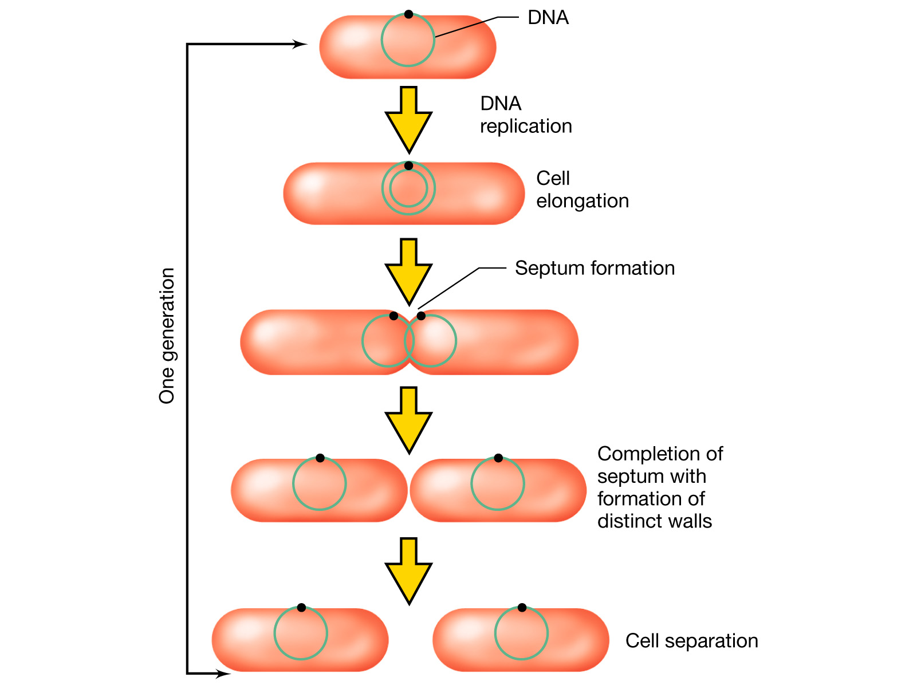
Bacterial Growth – binary fission
Notes:
Figure: 06-01
Caption:
The general process of binary fission in a rod-shaped prokaryote. For simplicity, the nucleoid is depicted as a single circle in green.

Slide 47
Binary Fission - unchecked
E. coli - generation time of 20 min.
20 generations (about 7 hrs.)
1 million cells
30 generations ( about 10 hrs.)
1 billion cells
72 generations ( about 24 hrs.)
1 x 10²¹
1,000,000,000,000,000,000,000 cells

Slide 48
Limiting factors in the environment
Lack of food, water or nutrients
space
accumulation of metabolic wastes
lack of oxygen
changes in pH
temperature

Slide 49
Bacterial Growth
Exponential growth via binary fission
Generation or doubling time (from 20 min to 24 h)
Phases of growth
Lag phase
Exponential (logarithmic [log]) phase
Stationary phase
Death phase
Compare growth in liquid and on solid media

Slide 50
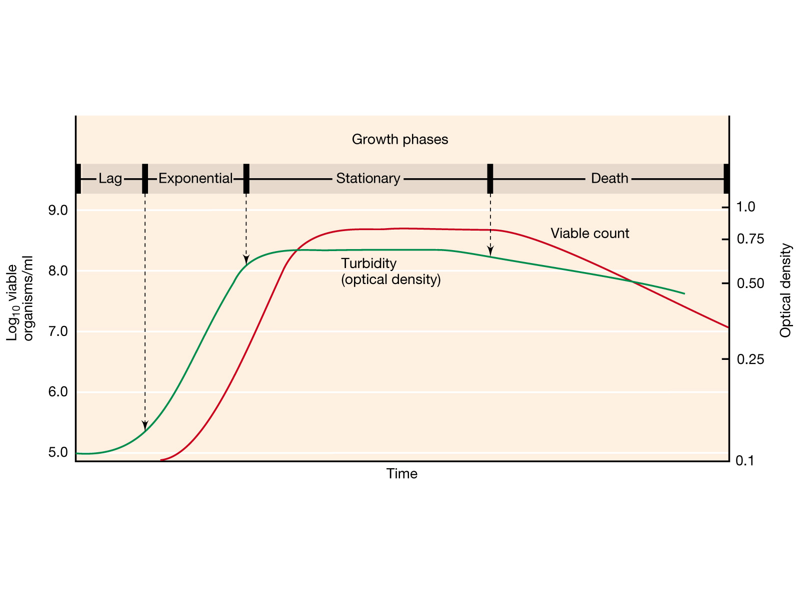
Bacterial growth curve in batch culture
Exponential growth = balanced growth
Notes:
Figure: 06-08
Caption: Typical growth curve for a bacterial population.
Four characteristic phases of the growth cycle are recognized.
1. Lag Phase. Immediately after inoculation of the cells into fresh medium, the population remains temporarily unchanged. Although there is no apparent cell division occurring, the cells may be growing in volume or mass, synthesizing enzymes, proteins, RNA, etc., and increasing in metabolic activity.
The length of the lag phase is apparently dependent on a wide variety of factors including the size of the inoculum; time necessary to recover from physiacal damage or shock in the transfer; time required for synthesis of essential coenzymes or division factors; and time required for synthesis of new (inducible) enzymes that are necessary to metabolize the substrates present in the medium.
2. Exponential (log) Phase. The exponential phase of growth is a pattern of balanced growth wherein all the cells are dividing regularly by binary fission, and are growing by geometric progression. The cells divide at a constant rate depending upon the composition of the growth medium and the conditions of incubation. The rate of exponential growth of a bacterial culture is expressed as generation time, also the doubling time of the bacterial population. Generation time (G) is defined as the time (t) per generation (n = number of generations). Hence, G=t/n is the equation from which calculations of generation time (below) derive.
3. Stationary Phase. Exponential growth cannot be continued forever in a batch culture (e.g. a closed system such as a test tube or flask). Population growth is limited by one of three factors: 1. exhaustion of available nutrients; 2. accumulation of inhibitory metabolites or end products; 3. exhaustion of space, in this case called a lack of "biological space".
During the stationary phase, if viable cells are being counted, it cannot be determined whether some cells are dying and an equal number of cells are dividing, or the population of cells has simply stopped growing and dividing. The stationary phase, like the lag phase, is not necessarily a period of quiescence. Bacteria that produce secondary metabolites, such as antibiotics, do so during the stationary phase of the growth cycle (Secondary metabolites are defined as metabolites produced after the active stage of growth). It si during the stationary phase that spore-forming bacteria have to induce or unmask the activity of dozens of genes that may be involved in sporulation process.
4. Death Phase. If incubation continues after the population reaches stationary phase, a death phase follows, in which the viable cell population declines. (Note, if counting by turbidimetric measurements or microoscopic counts, the death phase cannot be observed.). During the death phase, the number of viable cells decreases geometrically (exponentially), essentially the reverse of growth during the log phase.

Slide 51
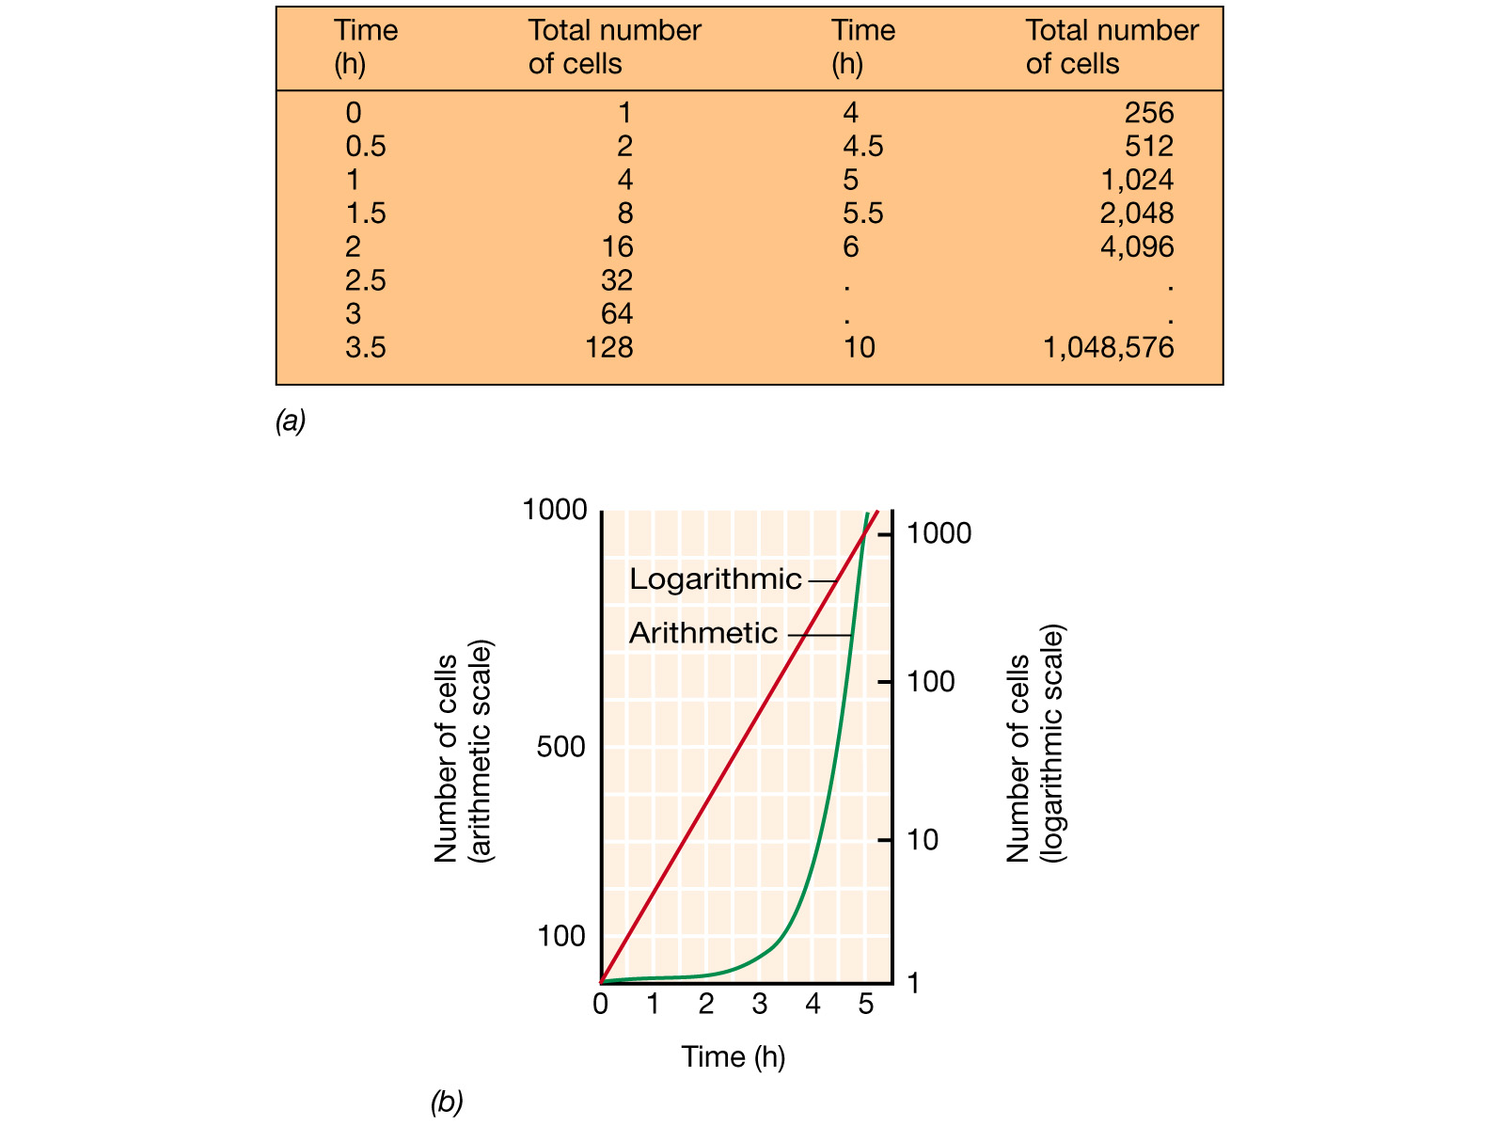
Bacterial growth rate
Notes:
Figure: 06-06a-b
Caption:
The rate of growth of a microbial culture. (a) Data for a population that doubles every 30 min. (b) Data plotted on an arithmetic (left ordinate) and a logarithmic (right ordinate) scale.

Slide 52
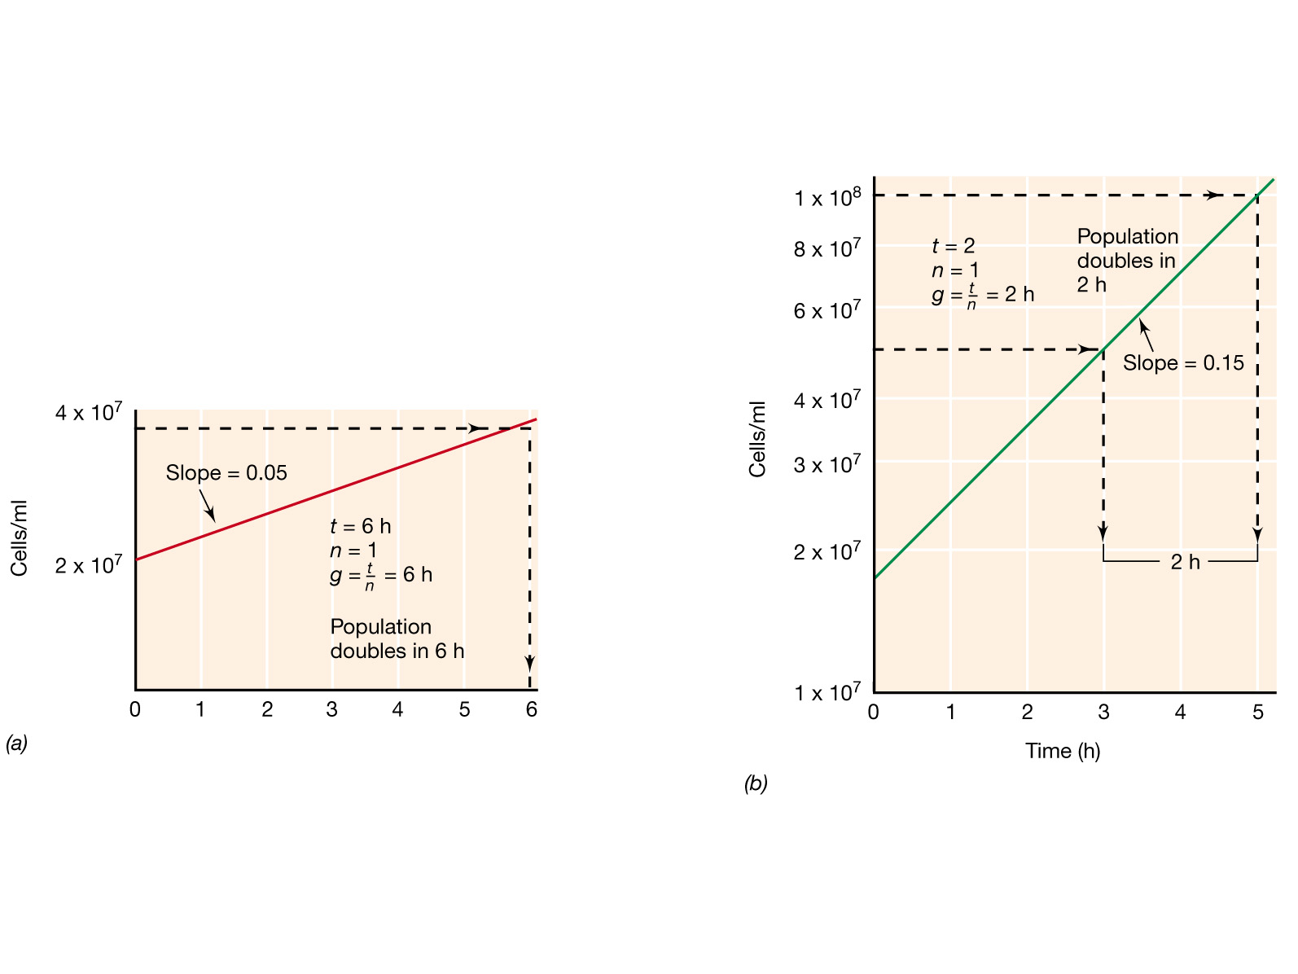
Calculating growth rate
Generation time (g) = t/n; where t = elapsed time (hr) and n= number of generations.
Notes:
Figure: 06-07a-b
Caption:
Method of estimating the generation times (g) of exponentially growing populations with generation times of (a) 6 h and (b) 2 h from data plotted on semilogarithmic graphs. The slope of each line is equal to 0.301/g and n equals the number of generations that have occurred in the time, t. All numbers are expressed in scientific notation; that is, 10,000,000 is 1 x 10⁷, 60,000,000 is 6 x 10⁷, and so on.

Slide 53
Generation times
Bacterium
Medium
Generation Time (minutes)
Escherichia coli
Glucose-salts
17
Bacillus megaterium
Sucrose-salts
25
Streptococcus lactis
Milk
26
Streptococcus lactis
Lactose broth
48
Staphylococcus aureus
Heart infusion broth
27-30
Lactobacillus acidophilus
Milk
66-87
Rhizobium japonicum
Mannitol-salts-yeast extract
344-461
Mycobacterium tuberculosis
Synthetic
792-932
Treponema pallidum
Rabbit testes
1980

Slide 54
Phases of Growth
4 Phases
1. Lag Phase
2. Log Phase
3. Stationary Phase
4. Death Phase

Slide 55
1. Lag Phase
Bacteria are first introduced into an environment or media
Bacteria are “checking out” their surroundings
cells are very active metabolically
# of cells changes very little
1 hour to several days

Slide 56
2. Log Phase
Rapid cell growth (exponential growth)
population doubles every generation
microbes are sensitive to adverse conditions
antibiotics
anti-microbial agents

Slide 57
3. Stationary Phase
Death rate = rate of reproduction
cells begin to encounter environmental stress
lack of nutrients
lack of water
not enough space
metabolic wastes
oxygen
pH
Endospores would form now

Slide 58
4. Death Phase
Death rate > rate of reproduction
Due to limiting factors in the environment

Slide 59
Enumeration of Bacteria
Turbid culture - 10 million bacterial cells per ml
Serial Dilution

Slide 60
Enumeration of soil microbial population:
Soil microbial distribution is extremely heterogeneous.
When enumerating the soil microbes we have to take following precautions.
take soil samples as much as possible
different growth media to grow them

Slide 61
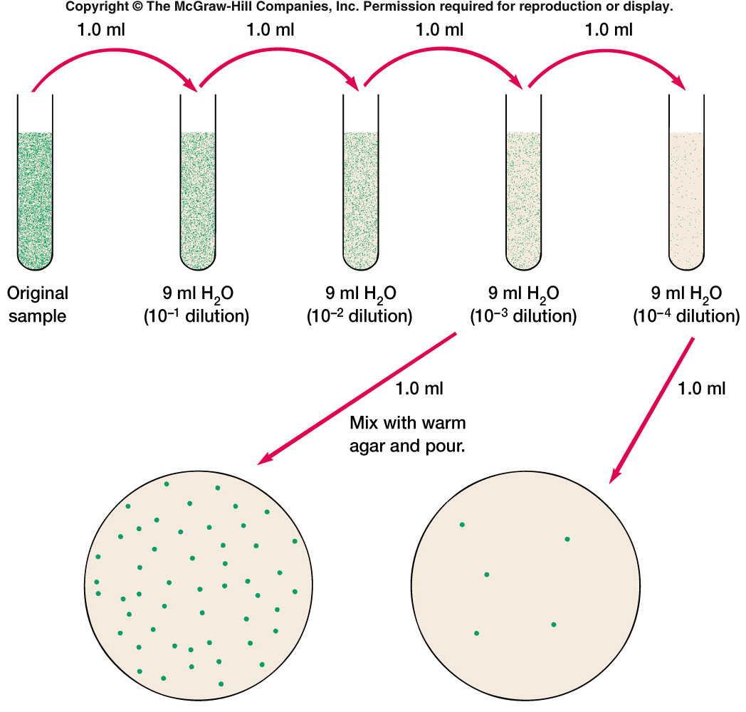
STANDARD PLATE COUNT TECHNIQUE

Slide 62
Ecological Concepts
Microbes account for ~ 50% of all biomass on Earth
They are ubiquitous on the surface and deep within the earth

Slide 63
Ecological Concepts
Population
A collection of organisms of the same species living within a localized area.
Ecosystem
The sum total of all organisms and abiotic factors in a particular environment
Habitat
Portion of an ecosystem where a microbial community could reside
An ecosystem contains many different habitats

Slide 64
Ecological Concepts
Many microbes establish relationships with other organisms (symbioses)
Parasitism
One member in the relationship is harmed and the other benefits
Mutualism
Both species benefit
Commensalism
One species benefits and the other is neither harmed nor helped

Slide 65
Ecological Concepts
The diversity of microbial species in an ecosystem can be expressed in two ways
Species richness: the total number of different species present
Species abundance: the proportion of each species in an ecosystem
Microbial species richness and abundance is a function of the kinds and amounts of nutrients available in a given habitat

Slide 66
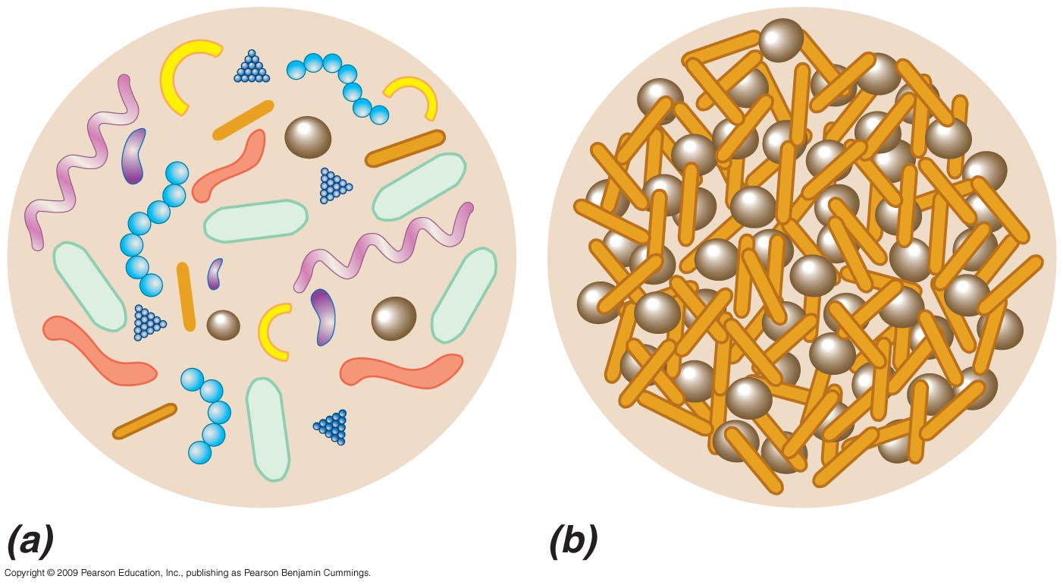
Microbial Species Diversity
High Species Richness and Low to
Moderate Abundance
Low Species Richness and High Abundance
Figure 23.1

Slide 67
Microbial Ecosystems
Guilds
Metabolically related microbial populations
Sets of guilds form microbial communities that interact with other larger organisms and abiotic factors in the ecosystem

Slide 68
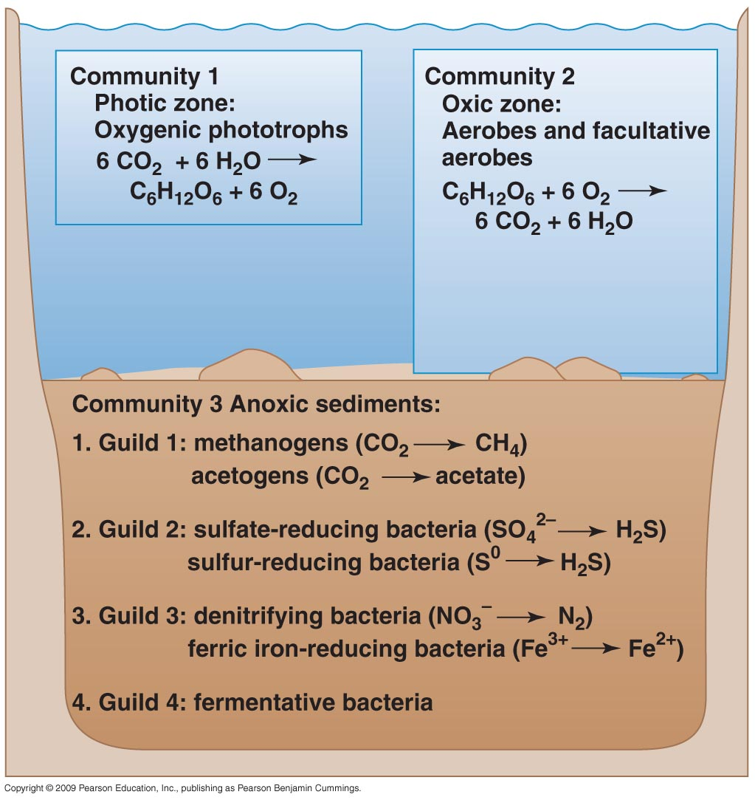
Populations, Guilds, and Communities

Slide 69
Environments and Microenvironments
The growth of microbes depends on resources and growth conditions
Difference in the type and quantity of resources and the physiochemical conditions of a habitat define the niche for each microbe
For each organism there exists at least one niche in which that organism is most successful (prime niche)
Microenvironment
The immediate environmental surroundings of a microbial cell or group of cells

Slide 70
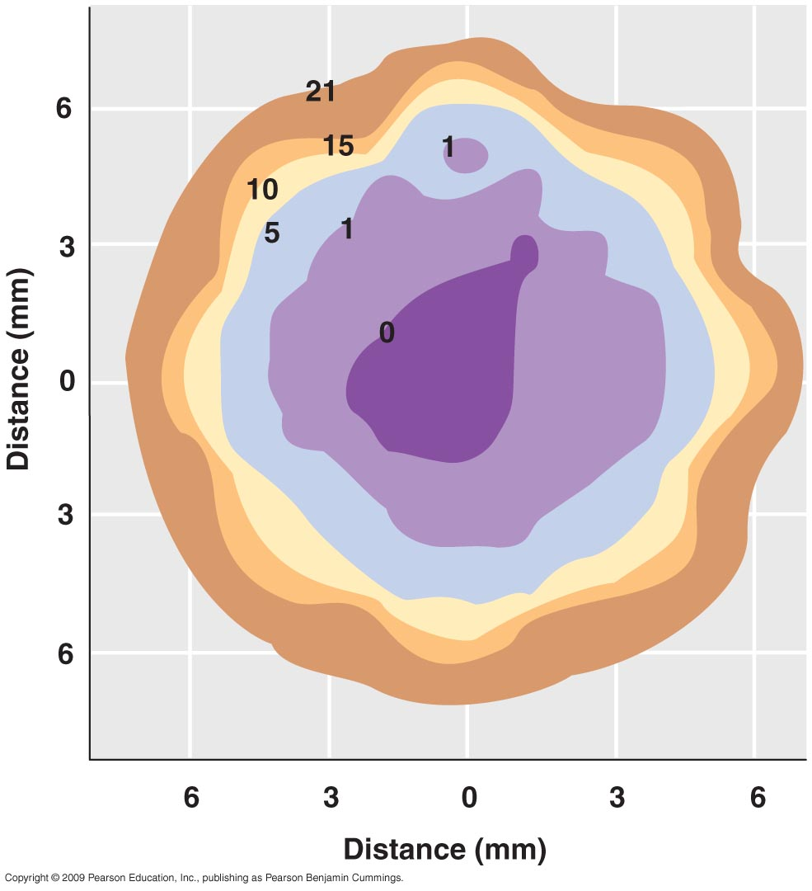
Oxygen Microenvironment
Figure 23.3

Slide 71
Environments and Microenvironments
Physiological and chemical conditions in a microenvironment are subject to rapid change, both spatially and temporally
Resources in natural environments are highly variable and many microbes in nature face a feast-or-famine existence
Growth rates of microbes in nature are usually well below maximum growth rates defined in the laboratory
Competition and cooperation occur between microbes in natural systems
To isolate a species from a mixture of species for laboratory study enrichment and selection are often necessary

Slide 72
Biofilms: Microbial Growth on Surfaces
Surfaces are important microbial habitats because
Nutrients adsorb to surfaces
Microbial cells can attach to surfaces

Slide 73
Biofilms: Microbial Growth on Surfaces
Biofilms
Assemblages of bacterial cells adhered to a surface and enclosed in an adhesive matrix excreted by the cells
The matrix is typically a mixture of polysaccharides
Biofilms trap nutrients for microbial growth and help prevent detachment of cells in flowing systems

Slide 74
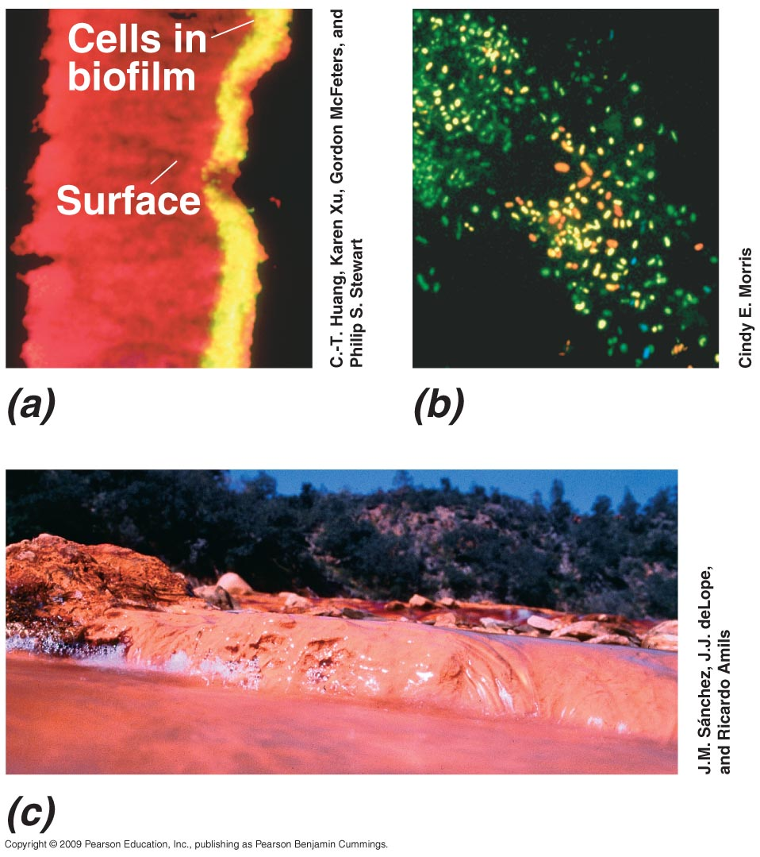
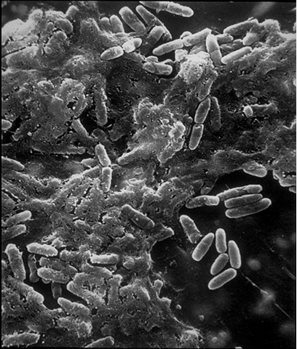
Examples of Microbial Biofilms
Biofilm on medical catheter
Natural Biofilm on a Leaf Surface
Cross-Sectional View of
Experimental Biofilm
Biofilm of Iron-Oxidizing Prokaryotes Attached to Rocks

Slide 75
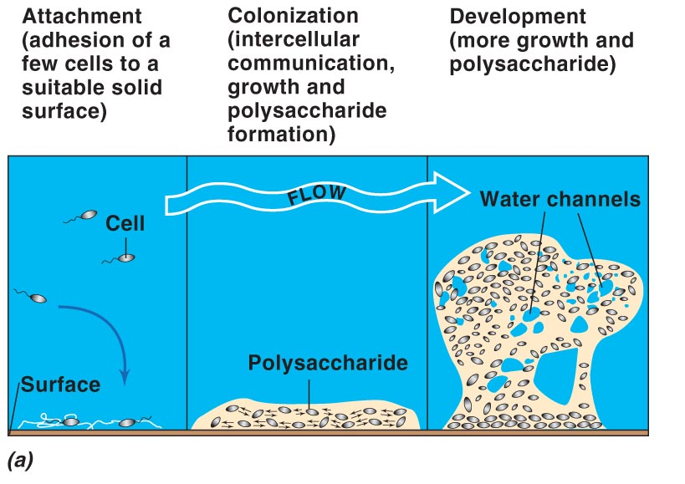
Biofilm Formation

Slide 76
Biofilms: Advantages and Control
Bacteria form biofilms for several reasons
Self-defense
Biofilms resist physical forces that sweep away unattached cells, phagocytosis by immune system cells, and penetration of toxins (e.g., antibiotics)
Allows cells to remain in a favorable niche
Allows bacterial cells to live in close association with one another

Slide 77
Biofilms: Advantages and Control
Biofilms are important in human health
Biofilms have been implicated in several medical and dental conditions
Including periodontal disease, kidney stones, tuberculosis, Legionnaire’s disease, and Staphylococcus infections
In industrial settings, biofilms can slow the flow of liquids through pipelines and can accelerate corrosion of inert surfaces
Few highly effective antibiofilm agents are available

Slide 78
Terrestrial Environments
Soil
The loose outer material of Earth’s surface
Distinct from bedrock
Soils are composed of
Inorganic mineral matter (~40% of soil volume)
Organic matter (~5%)
Air and water (~50%)
Living organisms

Slide 79
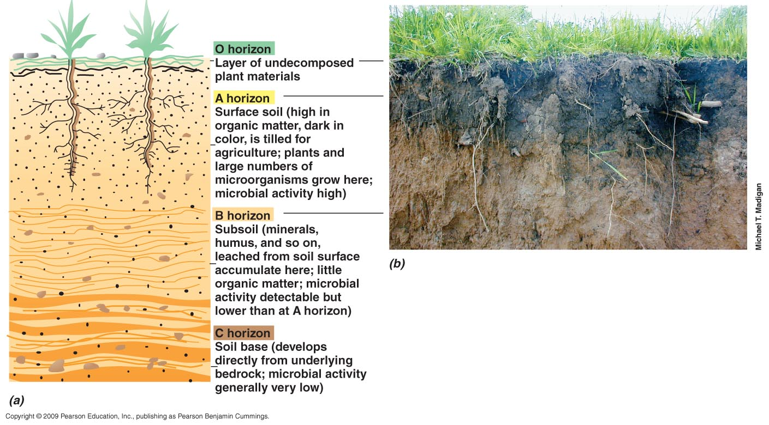
Profile of a Mature Soil

Slide 80
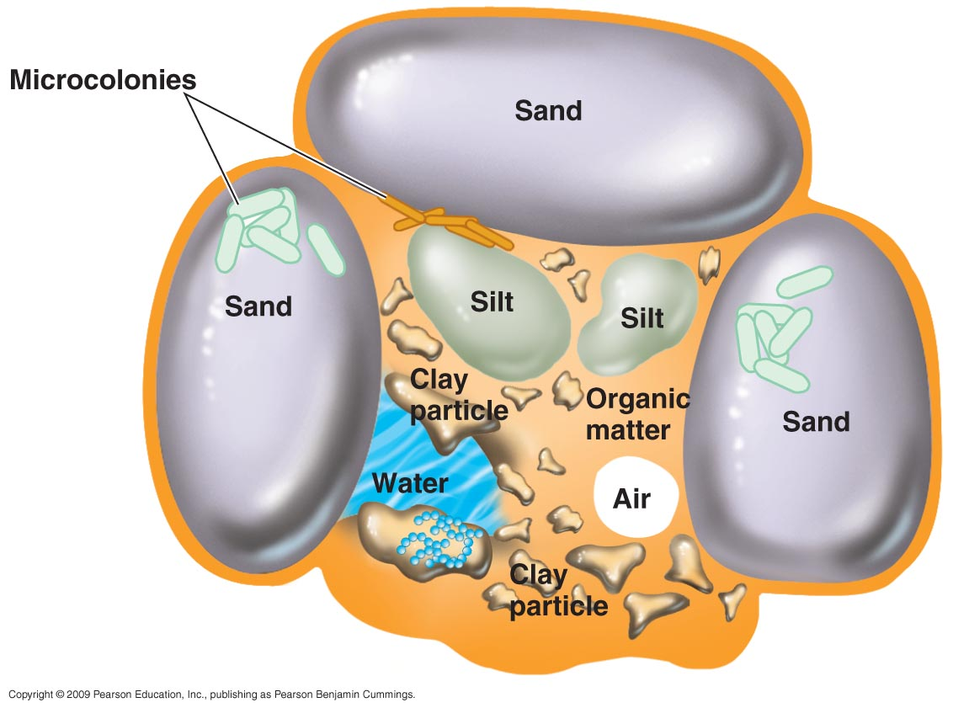
Terrestrial Environments
Most microbial growth takes place on the surfaces of soil particles
Soil aggregates can contain many different microenvironments supporting the growth of several types of microbes

Slide 81
Terrestrial Environments
The availability of water is the most important factor in influencing microbial activity in surface soils
Nutrient availability is the most important factor in subsurface environments

Slide 82
Plants as Microbial Habitats
Rhizosphere
The region immediately outside the root
Soil zone where microbial activity is usually high
Phyllosphere
The surface of plant leaf
Microbial communities form in both the rhizosphere and phyllosphere of plants
Microbes can prove both beneficial and harmful to plants
Many bacterial and fungal phytopathogens are known

Slide 83
Freshwater Environments
Freshwater environments are highly variable in the resources and conditions available for microbial growth
The balance between photosynthesis and respiration controls the oxygen and carbon cycles
Phytoplankton: oxygenic phototrophs suspended freely in water; include algae and cyanobacteria
Benthic species are attached to the bottom or sides of a lake or stream

Slide 84
Freshwater Environments
The activity of heterotrophic microbes in aquatic systems is highly dependent upon activity of primary producers; oxygenic phototrophs produce organic material and oxygen
Oxygen has limited solubility in water; once consumed in freshwater lakes the deep layers can become anoxic
Oxygen concentrations in aquatic systems is dependent on the amount of organic matter present and the physical mixing of the system

Slide 85
Freshwater Environments
Biochemical Oxygen Demand (BOD)
The microbial oxygen-consuming capacity of a body of water

Slide 86
Open Oceans
Compared with most freshwater environments, the open ocean environment is
Saline
Low nutrient; especially with respect to nitrogen, phosphorus, and iron
Cooler
Nearshore marine waters typically contain higher microbial numbers than the open ocean because of higher nutrient levels

Slide 87
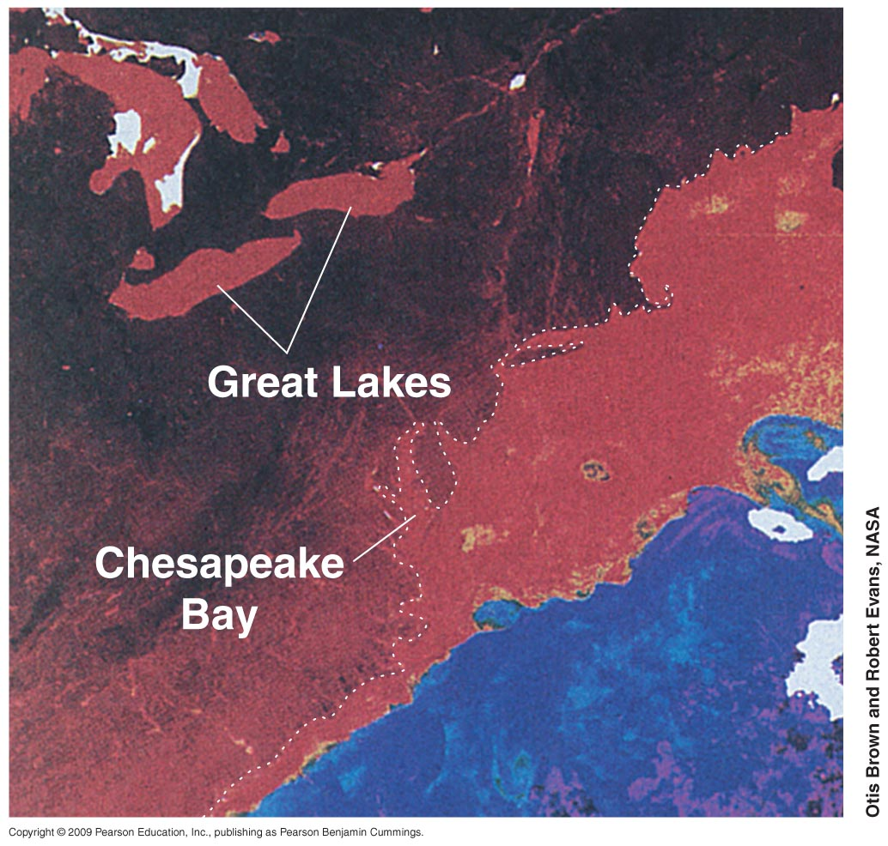
Distribution of Chlorophyll in the Western North Atlantic
Red areas are high in Chlorophyll. (phytoplankton)
Figure 23.14

Slide 88
Open Oceans
Most of the primary productivity in the open oceans is due to photosynthesis by prochlorophytes
Prochlorococcus accounts for
> 40% of the biomass of marine phototrophs
~50% of the net primary production

Slide 89
Open Oceans
The planktonic filamentous cyanobacterium Trichodesmium is an abundant phototroph in tropical and subtropical oceans
Small phototrophic eukaryotes, such as Ostreococcus, inhabit coastal and marine waters and are likely important primary producers

Slide 90
Open Oceans
Prokaryote densities in the open ocean decrease with depth
Surface waters contain ~10⁶ cells/ml; below 1,000 m cell numbers drop to 10³–10⁵/ml
Bacterial species tend to dominate in surface waters and Archaeal species dominate in deeper waters

Slide 91
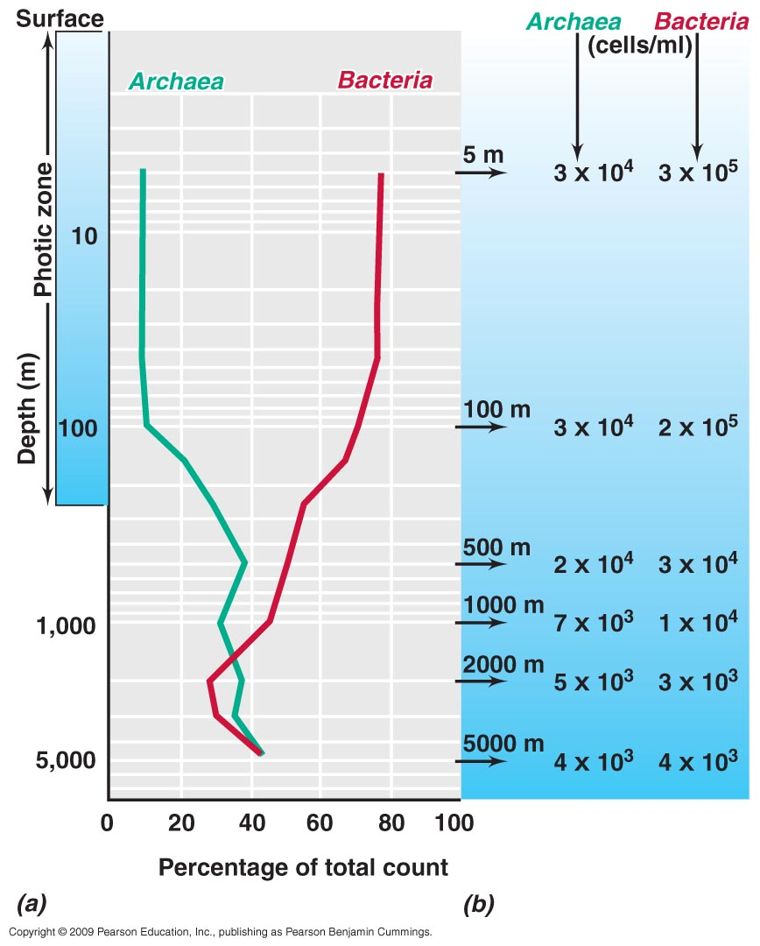
Percentage of Total Prokaryotes in the North Pacific Ocean
Figure 23.19

Slide 92
Open Oceans
Viruses are the most abundant microorganisms in the oceans (10⁷ virion particles/ml)
Viruses affect prokaryotic populations and are highly diverse

Slide 93
The Deep Sea and Barophilism
> 75% of all ocean water is deep sea, lying primarily between 1000 and 6000 m
Organisms that inhabit the deep sea must deal with
Low temperature
High pressure
Low nutrient levels
Absence of light energy

Slide 94
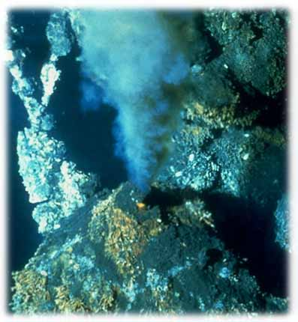
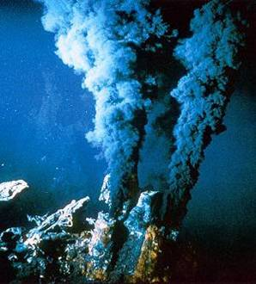
The Deep Sea and Barophilism
Deep sea microbes are
Psychrophilic (cold-loving) or psychrotolerant
Barophilic (pressure-loving) or barotolerant
Hydrothermal vent
Black Smoker

Slide 95
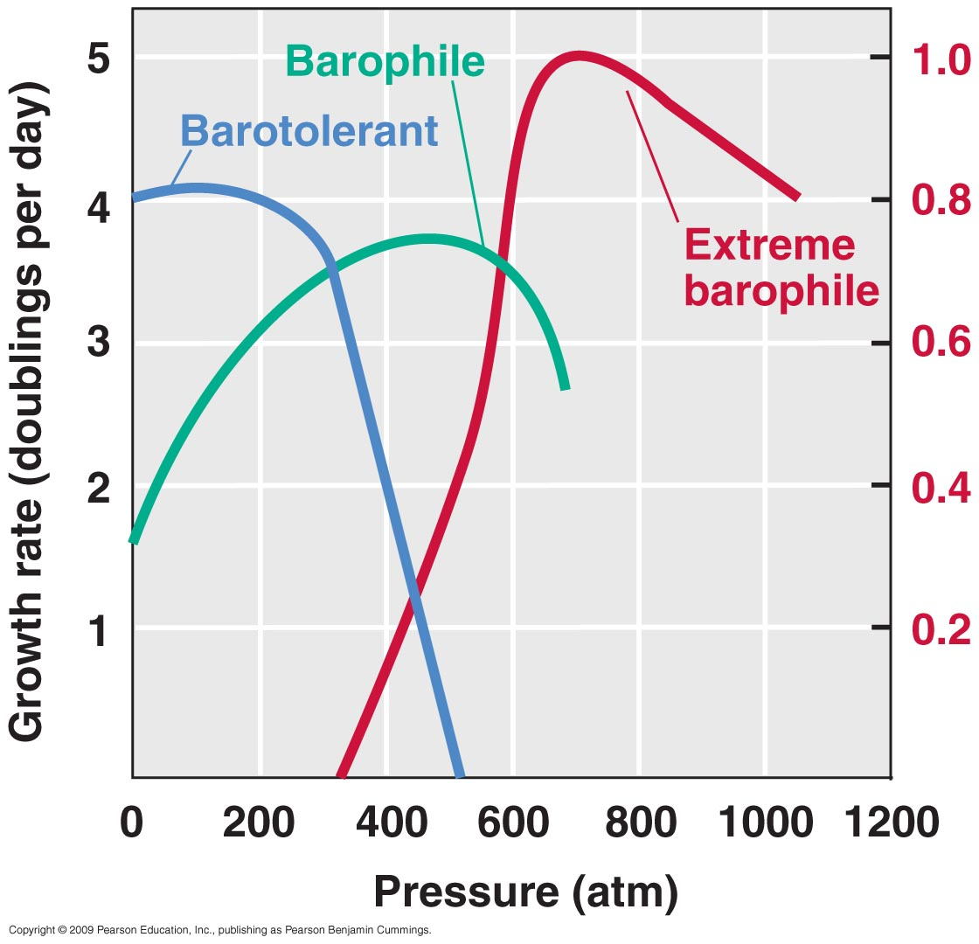
Growth of Barotolerant and Barophilic Bacteria
Figure 23.20

Slide 96
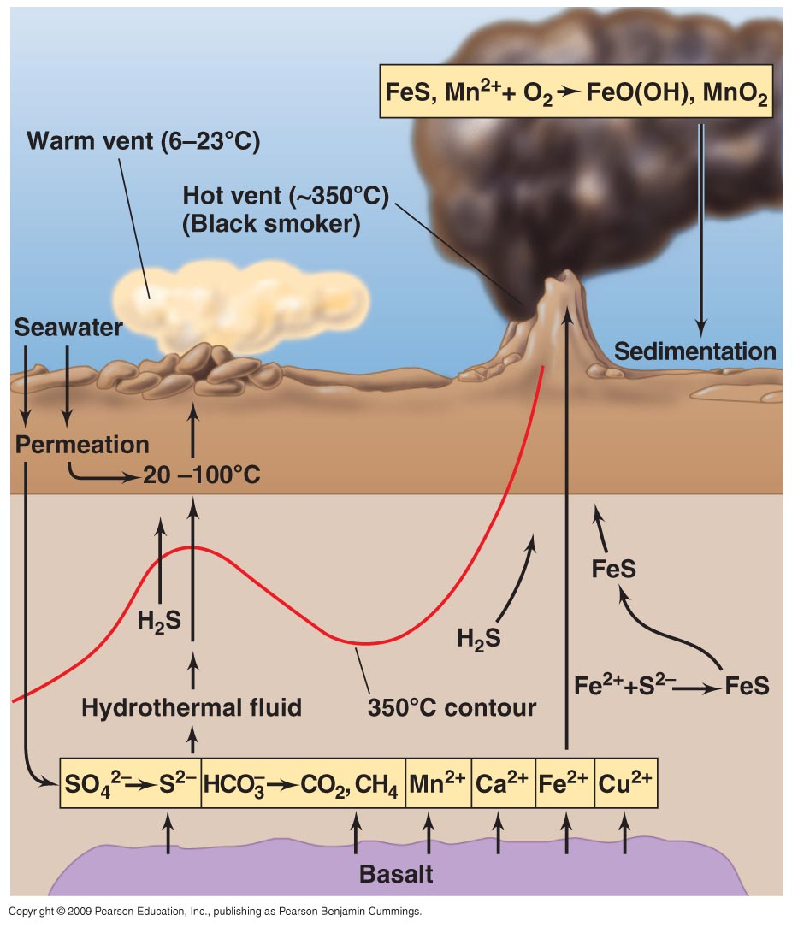
Hydrothermal Vent Microbial Ecosystems
Deep-sea hot springs (hydrothermal vents) support thriving animal communities that are fueled by chemolithotrophic microbes

Slide 97
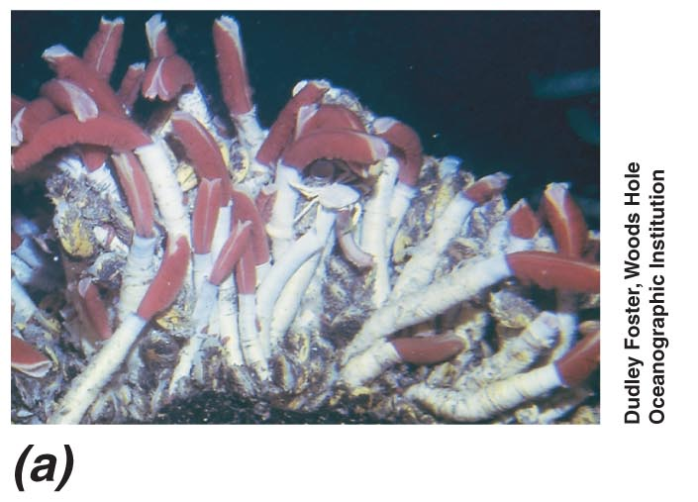
Hydrothermal Vent Microbial Ecosystems
Diverse invertebrate communities develop near hydrothermal vents, including large tube worms, clams, mussels
Chemolithotrophic prokaryotes that utilize reduced inorganic materials emitting from the vents form endosymbiotic relationships with vent invertebrates such as vent tube worms
Tube Worms

Slide 98
Microbial Ecology: Biogeochemical Cycles

Slide 99
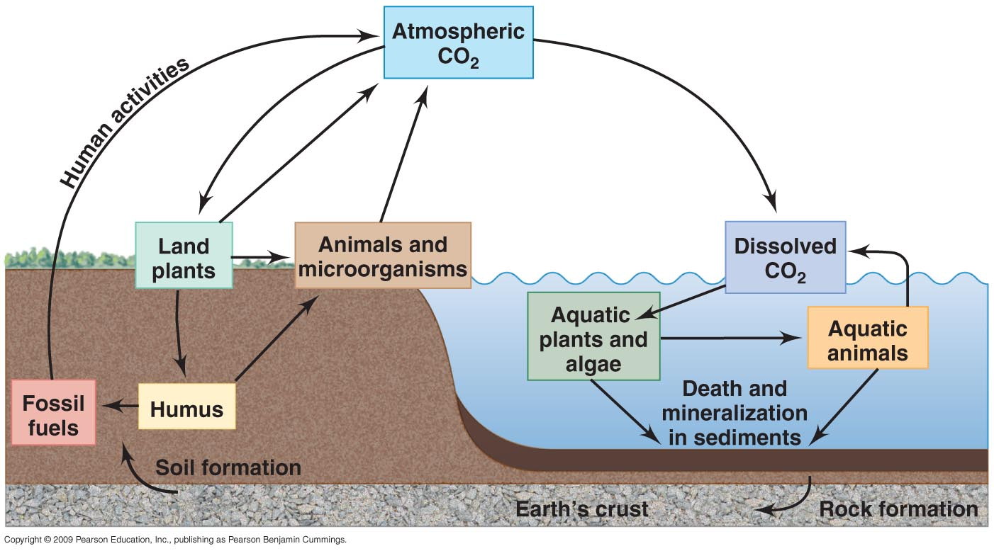
The Carbon Cycle
Carbon is cycled through all of Earth’s major carbon reservoirs (atmosphere, land, oceans, sediments, rocks, and biomass)

Slide 100

The Carbon Cycle
CO₂ in the atmosphere is the most rapidly transferred carbon reservoir
CO₂ is fixed primarily by photosynthetic land plants and marine microbes (autotrophs fix carbon dioxide)
CO₂ is returned to the atmosphere by respiration of animals and chemoorganotrophic microbes as well as by the activities of humans.
Microbial decomposition is the largest source of CO₂ released to the atmosphere

Slide 101
Carbon Cycle
Autotrophs fix carbon dioxide into organic molecules
Chemoheterotrophs eat autotrophs and each other (This moves the carbon atoms around the food chain)
As carbon containing organic compounds are used for energy (respiration) carbon dioxide is released into the atmosphere to start the cycle over again.
Also: when organisms die their remains are acted upon by bacteria and fungi (decomposers).Decomposition oxidizes the organic remains and carbon dioxide is liberated to reenter the cycle.

Slide 102
The Carbon Cycle….photosynthesis
Phototrophic organisms are the foundation of the carbon cycle
Oxygenic phototrophic organisms can be divided into two groups: plants and microorganisms
Plants are the dominant phototrophic organisms of terrestrial environments
Phototrophic microbes dominate aquatic environments

Slide 103
The Carbon Cycle
Photosynthesis and respiration are reverse reactions
Photosynthesis
CO₂ + H₂O (CH₂O) + O₂
Photsynthesis can be oxygenic or anoxygenic
Respiration
(CH₂O) + O₂ CO₂ + H₂O

Slide 104
Methanogenesis and Syntrophy
Most methanogens reduce CO₂ to CH₄ with H₂ as an electron donor; some can reduce other substrates to CH₄ (e.g., acetate)
Methanogens may team up with partners (syntrophs) that supply them with necessary substrates
_{Syntrophy:} A process whereby 2 or more microbes cooperate to degrade a substance neither can degrade _{alone}

Slide 105
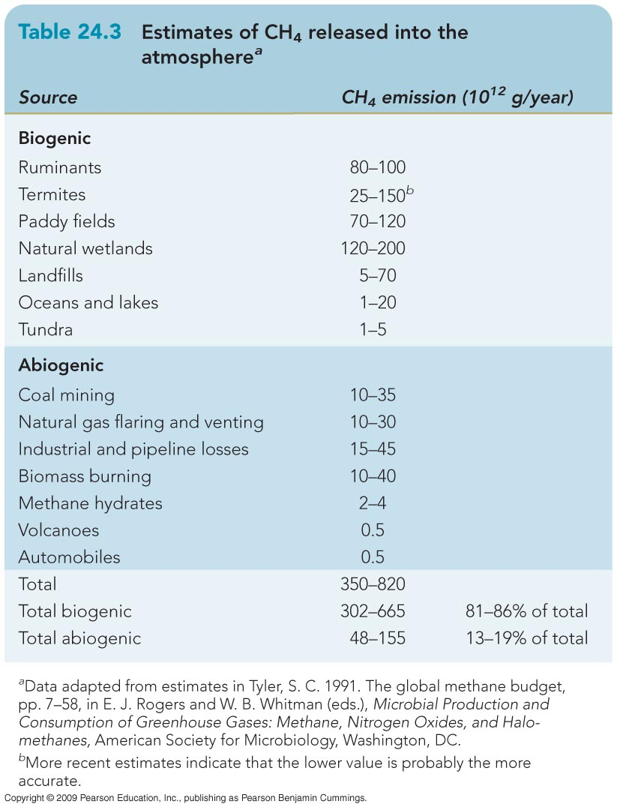
Methanogenesis
Methanogenic symbionts can be found in some protists that live in the gut of termites and ruminants
On a global basis, biotic processes release more CH₄ than abiotic processes

Slide 106
The Rumen and Ruminant Animals
Microbes form intimate symbiotic relationships with higher organisms
Ruminants
Herbivorous mammals (e.g., cows, sheep, goats)
Possess a special digestive organ (the rumen) within which cellulose and other plant polysaccharides are digested with the help of microbes

Slide 107
Nitrogen Cycle
Nitrogen is essential for amino acids, nucleic acids, etc.
80% of atmosphere is molecular nitrogen N₂
For plants to use nitrogen it must be fixed (combined with other elements). Only a few species of bacteria can fix nitrogen!!
Nitrogen fixation: nitrogen gas is converted to ammonia (requires enzyme nitrogenase)
Free-living nitrogen-fixing bacteria
Symbiotic nitrogen-fixing bacteria

Slide 108
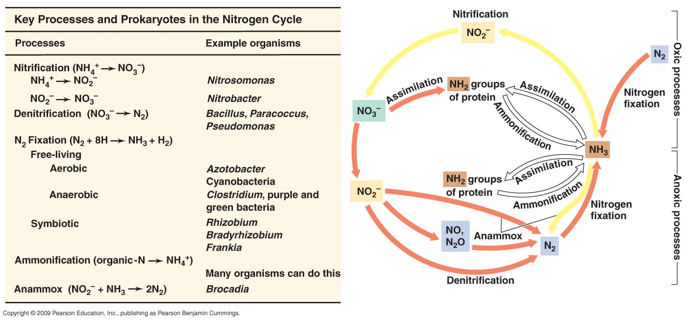
Redox Cycle for Nitrogen

Slide 109
The Nitrogen Cycle
Ammonification
Microbes decompose proteins to amino acids. The amino acids can undergo deamination which produces ammonia (NH₃)
Ammonia produced by nitrogen fixation or ammonification can be assimilated into organic matter or oxidized to nitrate
Nitrification the oxidation of ammonia to produce nitrate.
Plants use nitrate as their principle source of nitrogen
Nitrobacter and Nitrosomonas are genera of nitrifying bacteria

Slide 110
Nitrogen Cycle
Denitrification is the reduction of nitrate (NO₃ ) to gaseous nitrogen products (N₂ O and N₂ ) and is the primary mechanism by which N₂ is produced biologically
Pseudomonas spp. are important bacteria in the denitrification of soils
Anammox is the anaerobic oxidation of ammonia to N₂ gas
Denitrification and anammox result in losses of nitrogen from the biosphere

Slide 111
The Sulfur Cycle
H₂S (Hydrogen sulfide…reduced form of sulfur) is an energy source for some autotrophs
Photoautrophs (green and purple bacteria groups)
Chemoautoatrophs (Beggiatoa and Thiobacillus)
Oxidation of sulfur
H₂S ----------→ elemental sulfur (S) ----------→ SO₄
Sulfate (SO₄) is assimilated by plants and bacteria into proteins
Decomposition by microbes releases sulfur (dissimulation) as H₂S to reenter the cycle

Slide 112
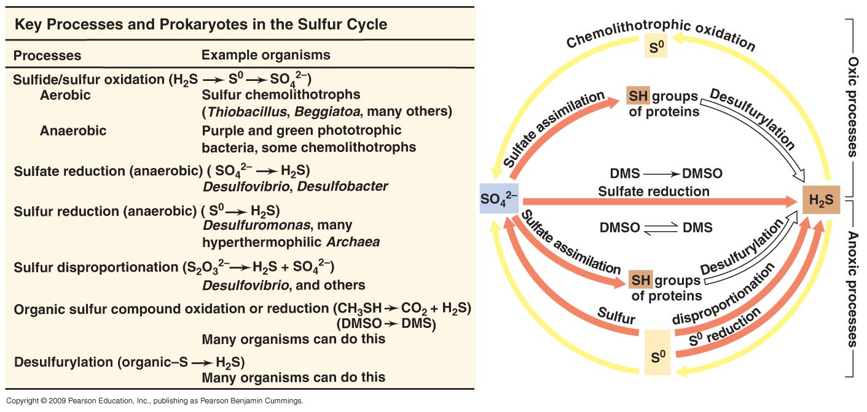
Redox Cycle for Sulfur
Figure 24.6

Slide 113
Phosphorus Cycle
Phosphorus exists mainly as phosphate (PO₄) ions
The phosphorus cycle mainly involves changes from soluble to insoluble forms of phosphate.
Microbes (such as Thiobacillus) may produce acids that solubilize the phosphate and make it available for plants and other microbes.

Slide 114
Microbial Leaching of Ores
Microbial Leaching
The removal of valuable metals, such as copper, from sulfide ores by microbial activities
Particularly useful for copper ores
In microbial leaching, low-grade ore is dumped in a large pile (the leach dump) and sulfuric acid is added to maintain a low pH
Microbial activity releases soluble pure metals
The liquid emerging from the bottom of the pile is enriched in dissolved metals and is transported to a precipitation plant

Slide 115
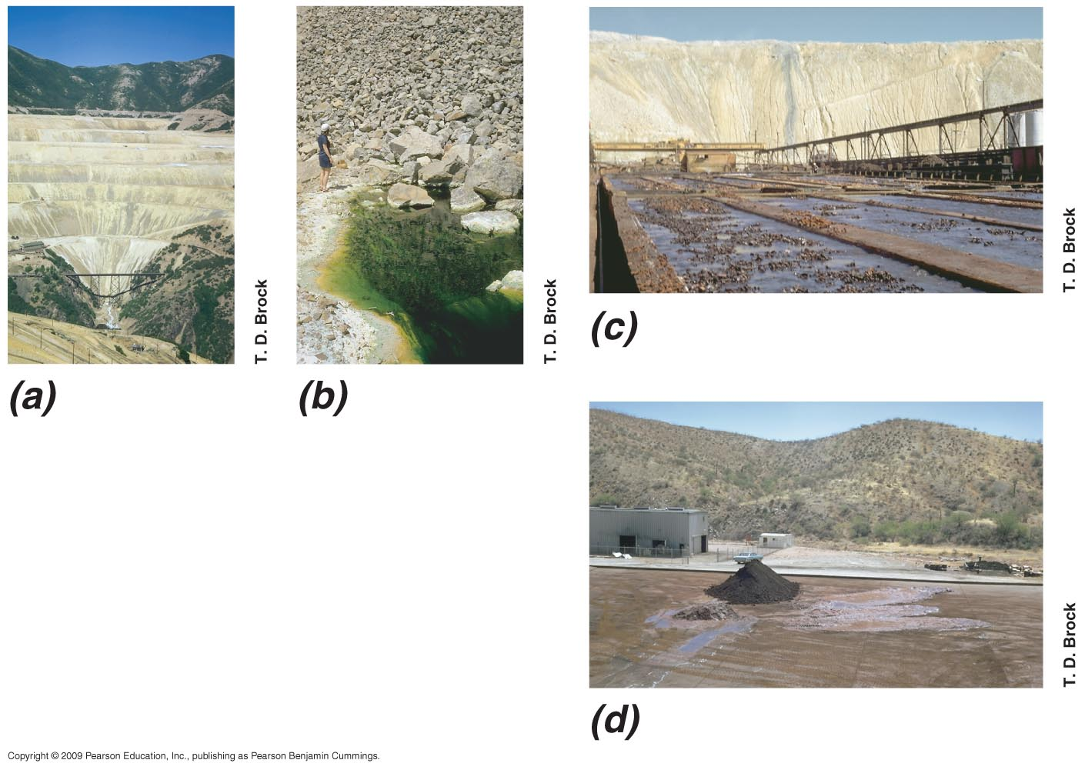
The Microbial Leaching of Low-Grade Copper Ores
Recovery of Copper as a Metallic Copper
A Typical Leaching Dump
Effluent from a Copper
Leaching Dump
Small Pile of Metallic Copper Removed from the Flume

Slide 116
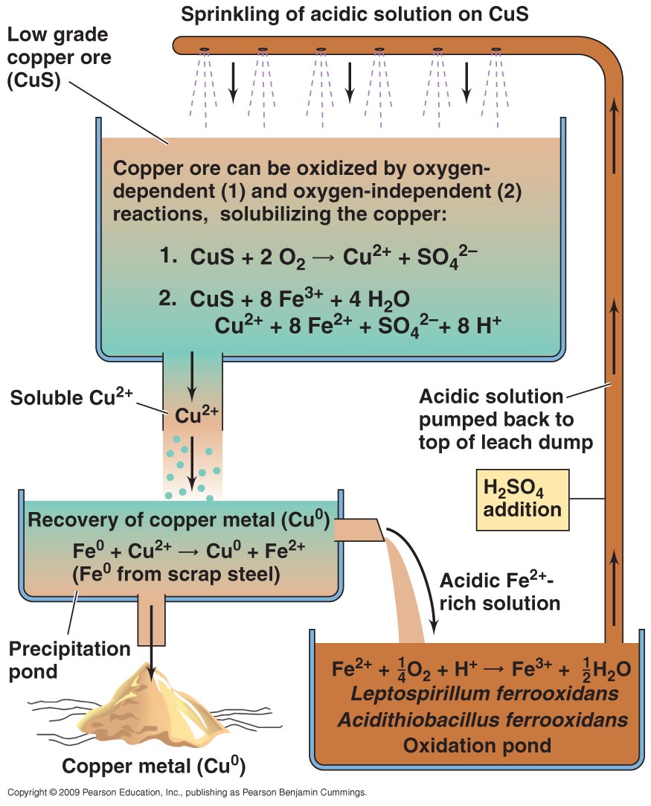
Arrangement of a Leaching Pile and Reactions
Figure 24.15

Slide 117
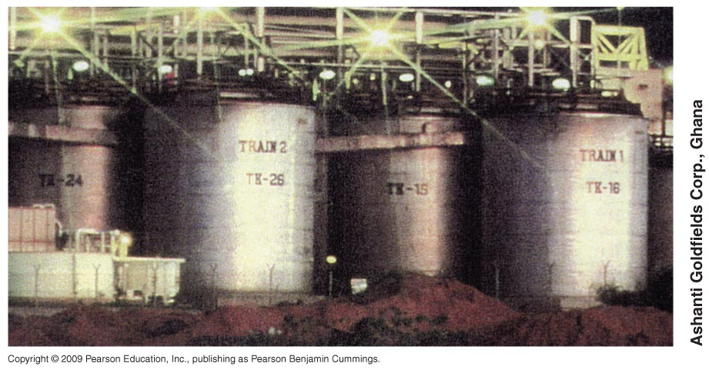
Microbial Leaching of Ores
Microbes are also used in the leaching of uranium and gold ores
Gold leaching tanks

Slide 118
Degradation of Chemical by Microbes

Slide 119
Bioremediation
Bioremediation
Refers to the cleanup of oil, toxic chemicals, or other pollutants from the environment by microorganisms
Often a cost-effective and practical method for pollutant cleanup

Slide 120
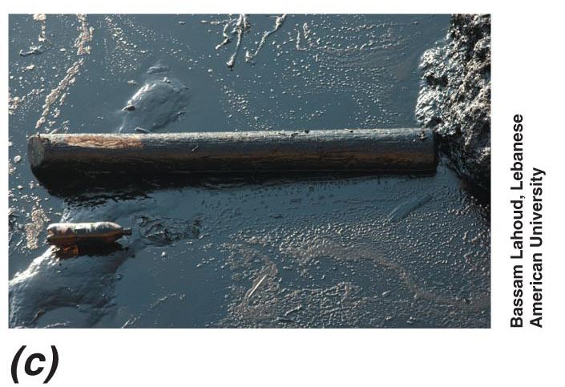
Petroleum Biodegradation
Prokaryotes have been used in bioremediation of several major crude oil spills
Oil Spilled into the Mediterranean Sea

Slide 121
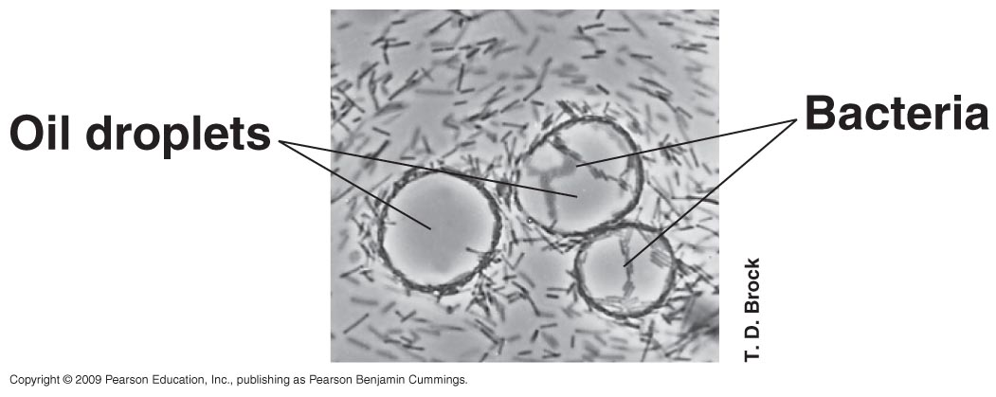
Petroleum Biodegradation
Diverse bacteria, fungi, and some cyanobacteria and green algae can oxidize petroleum products aerobically
Oil-oxidizing activity is best if temperature and inorganic nutrient concentrations are optimal
Hydrocarbon-degrading bacteria attach to oil droplets and decompose the oil and dispense the slick

Slide 122
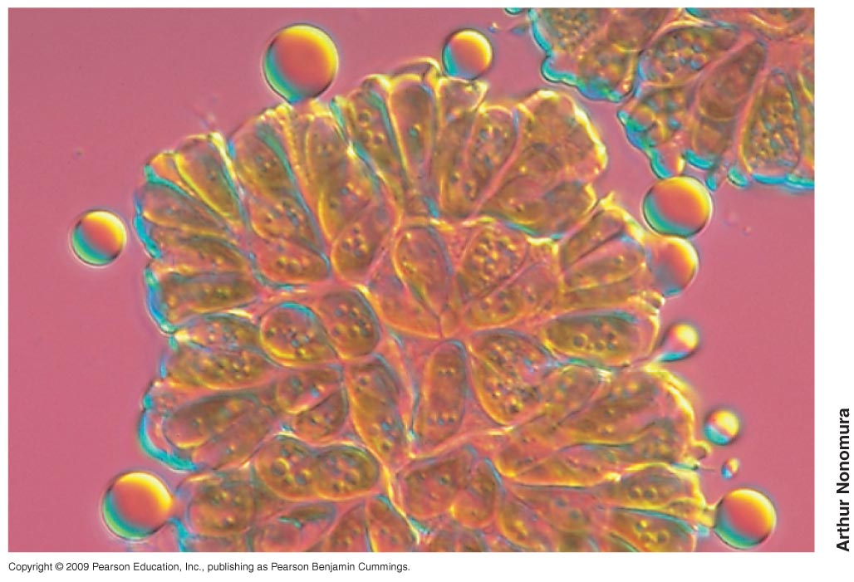
Petroleum Biodegradation
Some microbes can produce petroleum
Particularly certain green algae
The green alga Botryococcus braunii shown here is excreting oil droplets

Slide 123
Biodegradation of Xenobiotics
Xenobiotic Compound
Synthetic chemicals that are not naturally occurring
E.g., pesticides, polychlorinated biphenyls, munitions, dyes, and chlorinated solvents
Many degrade extremely slowly

Slide 124
Biodegradation of Xenobiotics
Pesticides
Common components of toxic wastes
Include herbicides, insecticides, and fungicides
Represent a wide variety of chemicals
Some of which can be used as carbon sources and electron donors by microbes

Slide 125
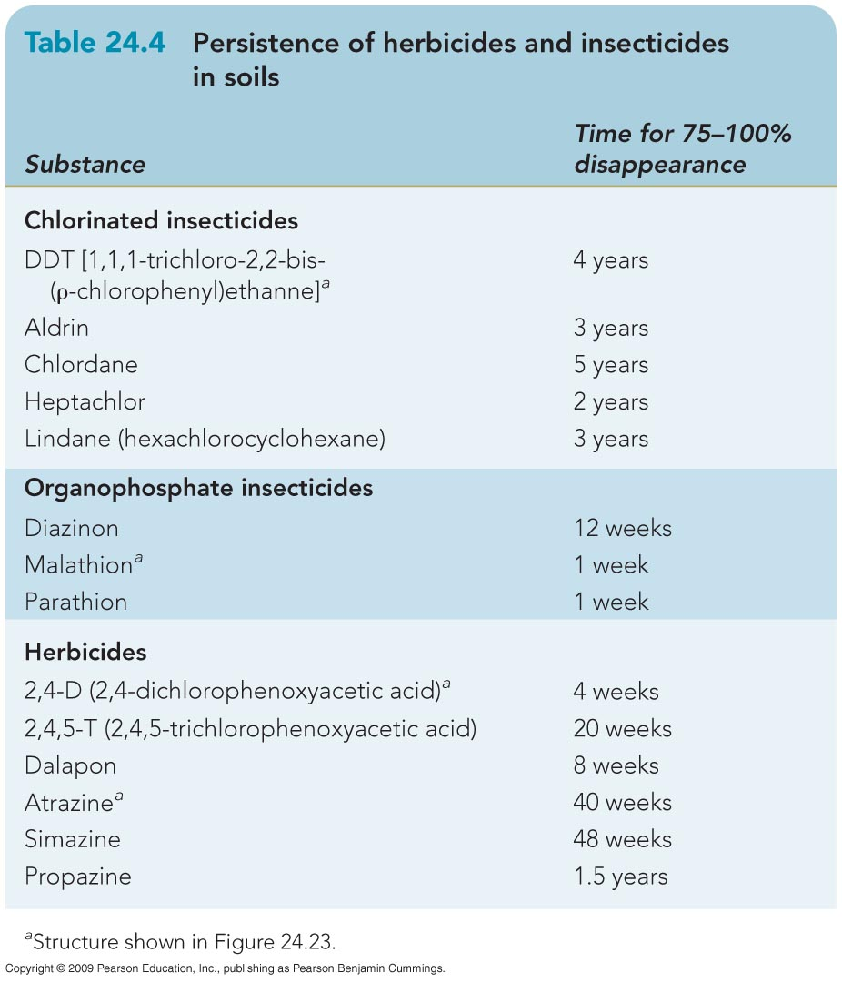
Persistence of Herbicides and Insecticides in Soils

Slide 126
Persistence of Herbicides and Insecticides in Soils

Slide 127
Biodegradation of Xenobiotics
Some xenobiotics can be degraded partially or completely if another organic material is present as a primary energy source (cometabolism)

Slide 128
Biodegradation of Xenobiotics
Plastics of various types are xenobiotics that are not readily degraded by microbes
The recalcitrance of plastics has fueled research efforts into a biodegradable alternative (biopolymers)

Slide 129
Plant–Microbial Symbioses

Slide 130
Lichens
Leafy or encrusting microbial symbiosis
Often found growing on bare rocks, tree trunks, house roofs, and the surfaces of bare soils
Consist of a mutalistic relationship between a fungus and an alga (or cyanobacterium)
Alga is photosynthetic and produces organic matter for the fungus
The fungus provides a structure within which the phototrophic partner can grow protected from erosion by rain or wind

Slide 131
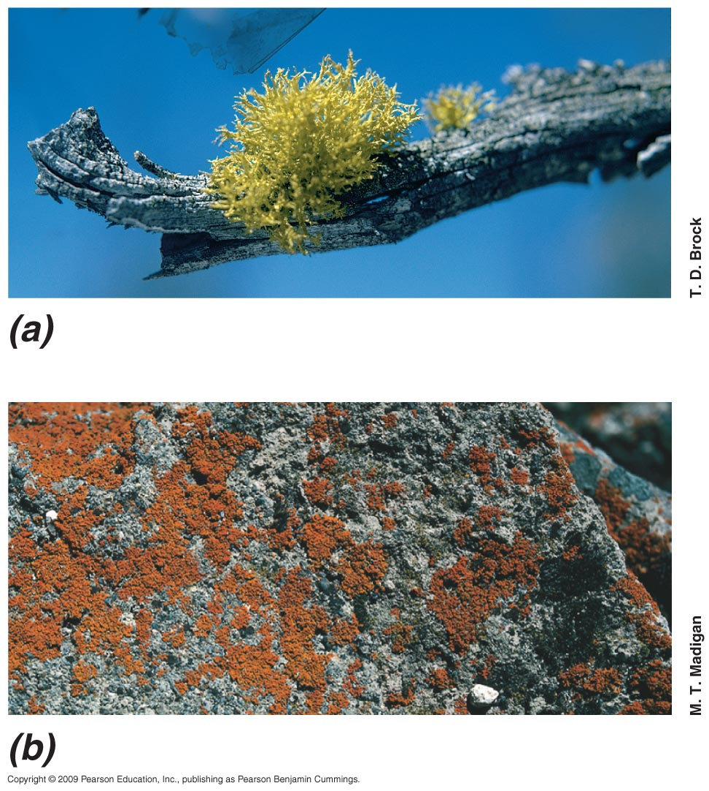
Lichens

Slide 132
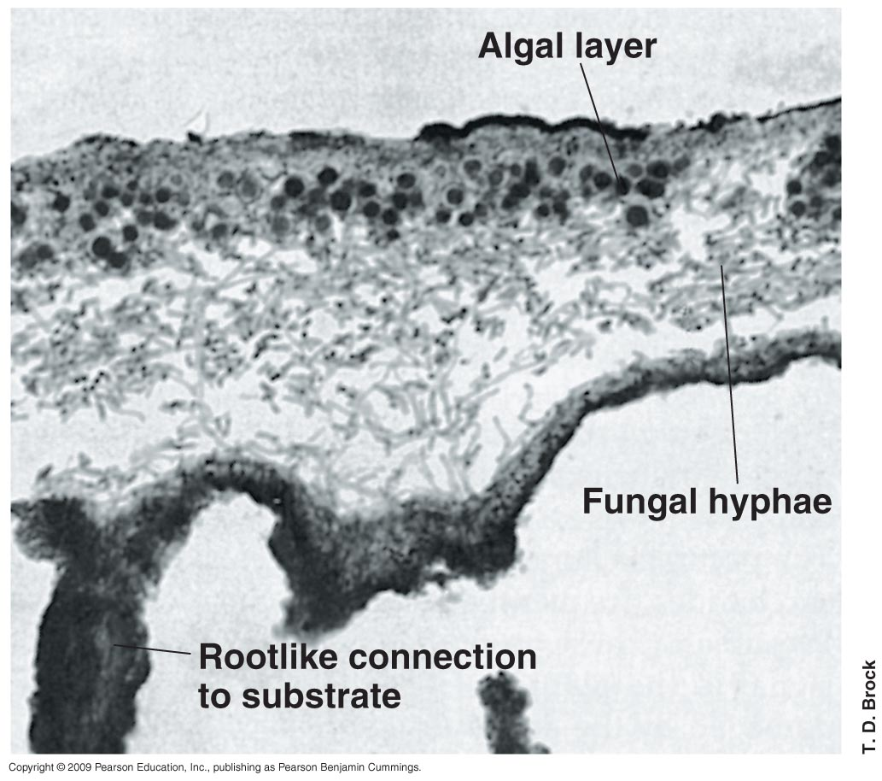
Lichen Structure

Slide 133
Mycorrhizae
Mycorrhizae
Mutalistic associations of plant roots and fungi
Two classes
Ectomycorrhizae
Endomycorrhizae
Mycorrhizal fungi assist plants by
Improving nutrient absorption
This is due to the greater surface area provided by the fungal mycelium

Slide 134

Mycorrhizae
Ectomycorrhizae
Fungal cells form an extensive sheath around the outside of the root with only a little penetration into the root tissue
Found primarily in forest trees
Mycorrhizae: Typical Ectomycorrhizal Root of pine tree

Slide 135
Mycorrhizae
Lodgepole pine seedling showing extensive ectomycorrhizal network which enhances uptake of nutrients from the soil

Slide 136
Mycorrhizae
Endomycorrhizae
Fungal mycelium becomes deeply embedded within the root tissue
Are more common than ectomycorrhizae
Found in >80% of terrestrial plant species

Slide 137

Effect of Mycorrhizal Fungi on Plant Growth
Pine seedings
No mycorrhizal fungi with mycorrhizal fungi

Slide 138
The Legume–Root Nodule Symbiosis
mutalistic relationship between leguminous plants and nitrogen-fixing bacteria is one of the most important symbioses known
Examples of legumes include soybeans, clover, alfalfa, beans, and peas
Rhizobia are the most well-known nitrogen-fixing bacteria engaging in these symbioses

Slide 139
The Legume–Root Nodule Symbiosis
Infection of legume roots by nitrogen-fixing bacteria leads to the formation of root nodules that fix nitrogen
Leads to significant increases in combined nitrogen in soil
Nodulated legumes grow well in areas where other plants would not

Slide 140

Soybean Root Nodules

Slide 141

Effect of Nodulation on Plant Growth
Soybeans without nodules Soybeans with root nodules

